Slide 1

Chiropractic Memphis
Cares

Slide 2
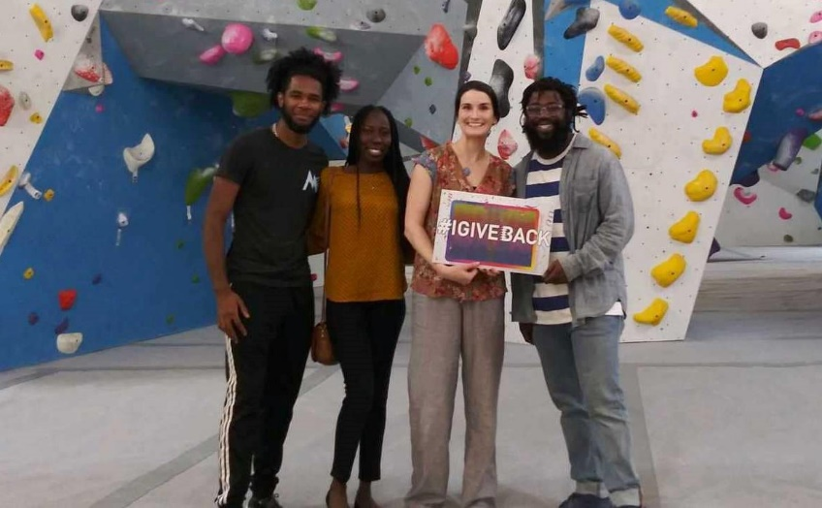
The Give Back
Movement
The Give Back Movement is a national chiropractic awareness program that allows us to offer free wellness programs.
The Give Back Screening - Free spinal screenings that show areas of stress, tension, and balance.
The Give Back Lunch & Learn - Living Well For Life Presentation to increase both quantity and quality of life.
Designed to:
Inform the community on the best ways to maintain healthy lifestyles
Give the secrets to achieving overall health and wellness
Help improve daily mobility and job function
Special offer: Receive a doctor consultation, exam, initial x-rays,
and a detailed report of findings for a fee of only $40!

Slide 3

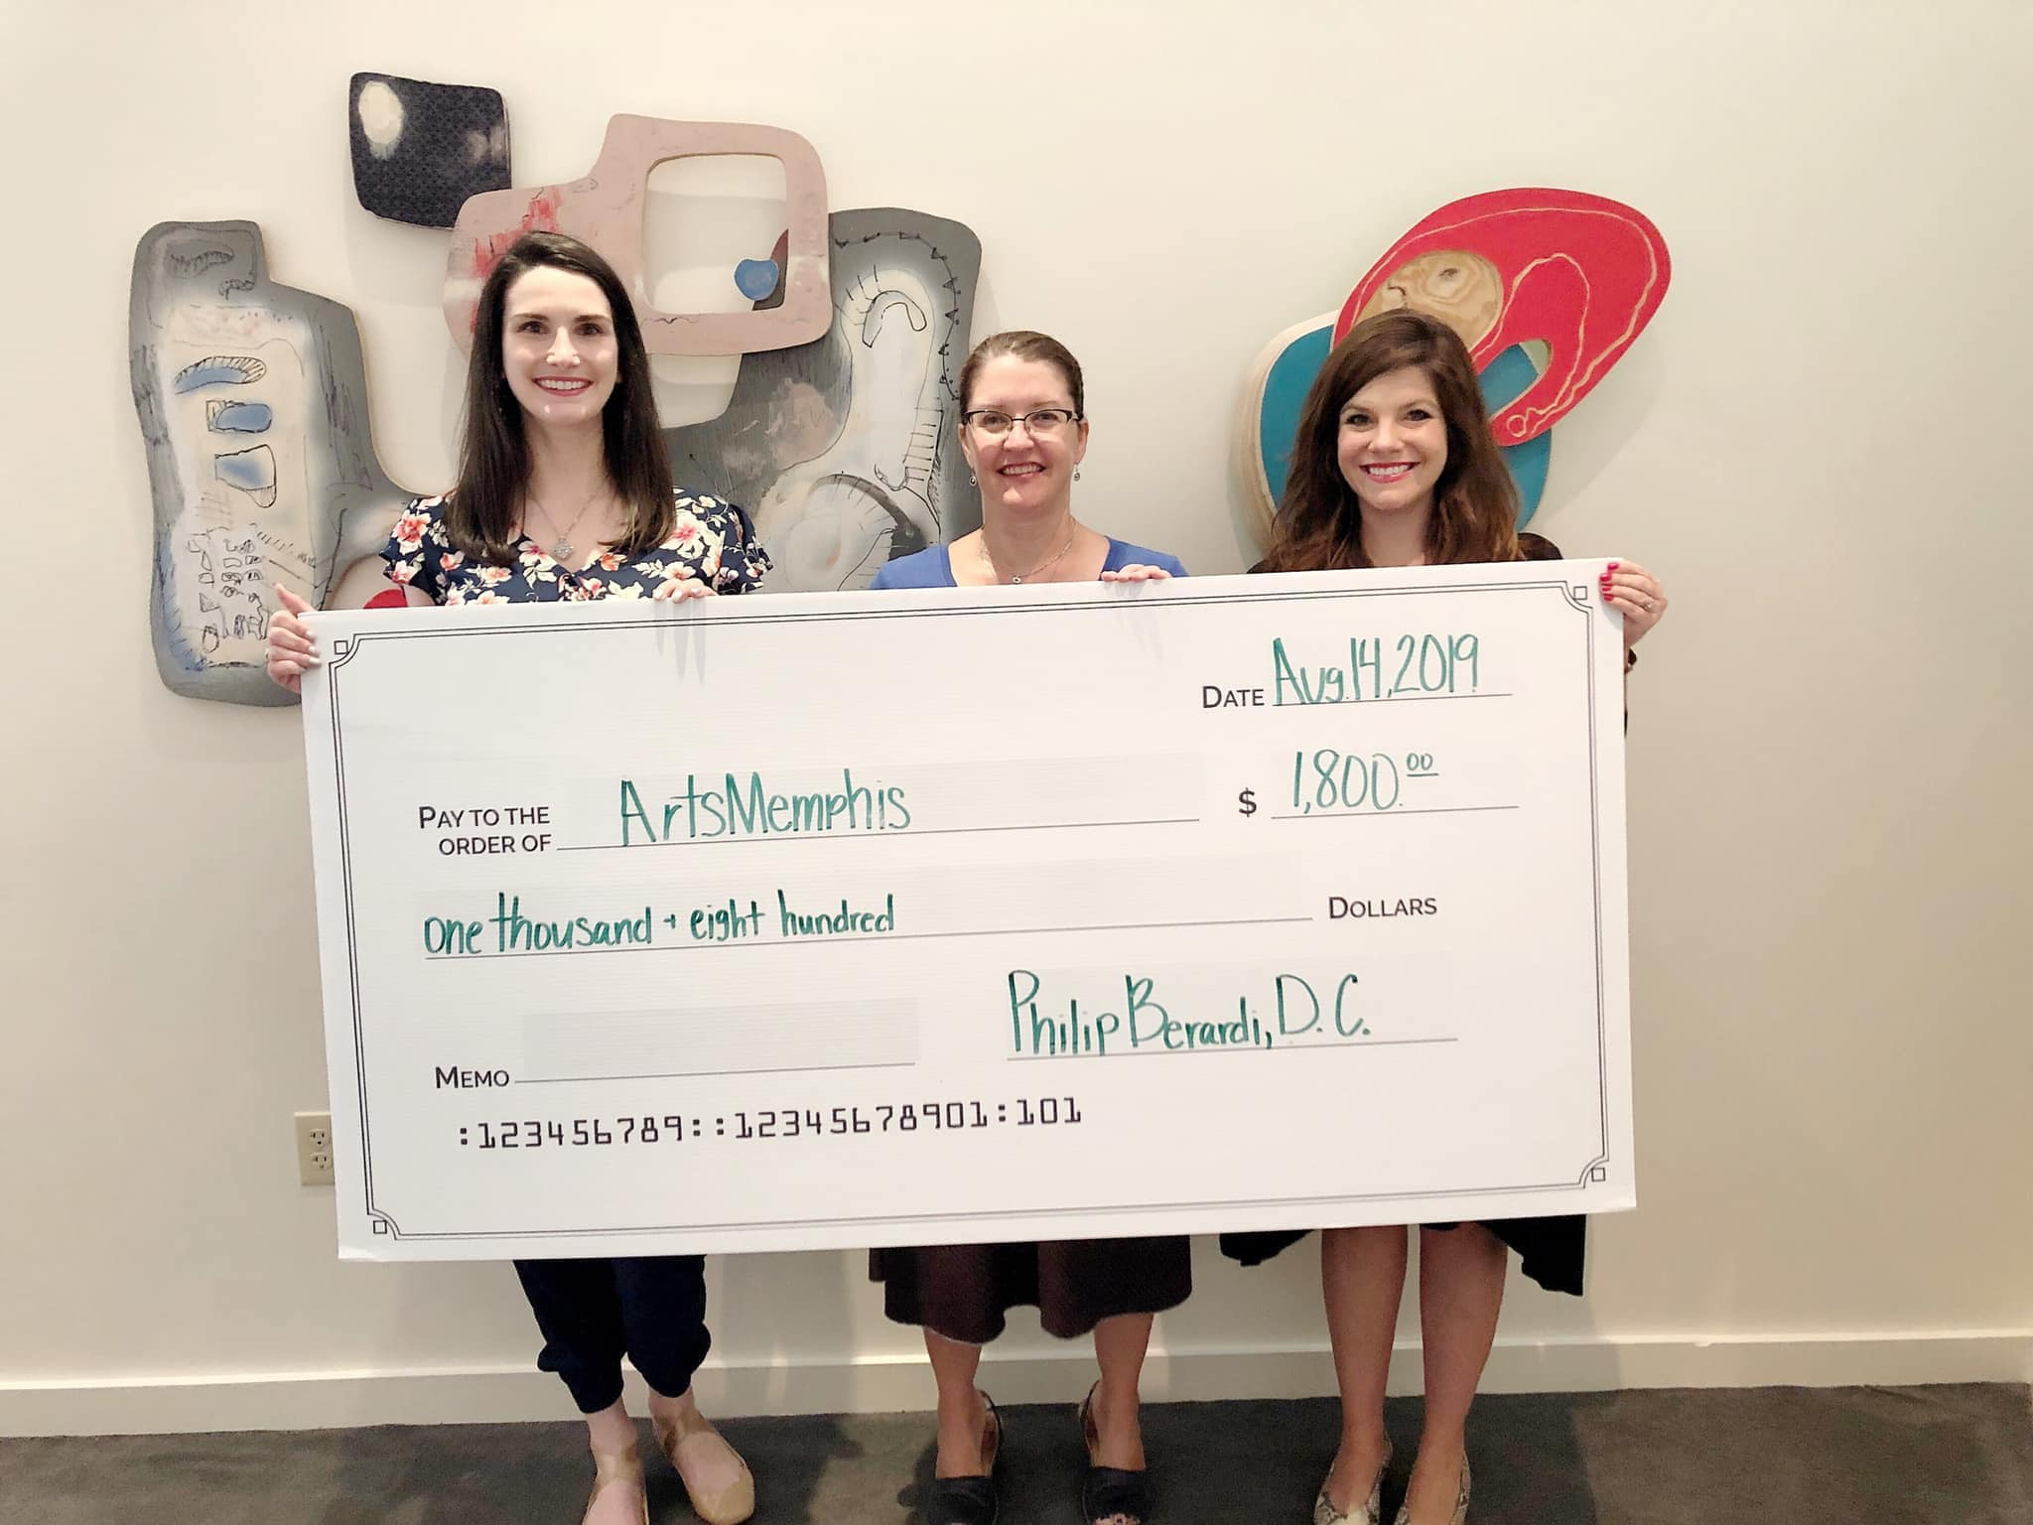
Philanthropic Partnerships
To Give Back Even More…
100% of the new patient fees are donated back to local non-profits and organizations.
Relationship Opportunities:
Health fairs
Expos/Festivals
Community events
Meetings
Social Groups
Office staff
Fundraisers
School screenings
Small Businesses
Safety Presentations

