Slide 1
Introduction to Concentra
City of Memphis
Thursday November 5, 2020

Slide 2
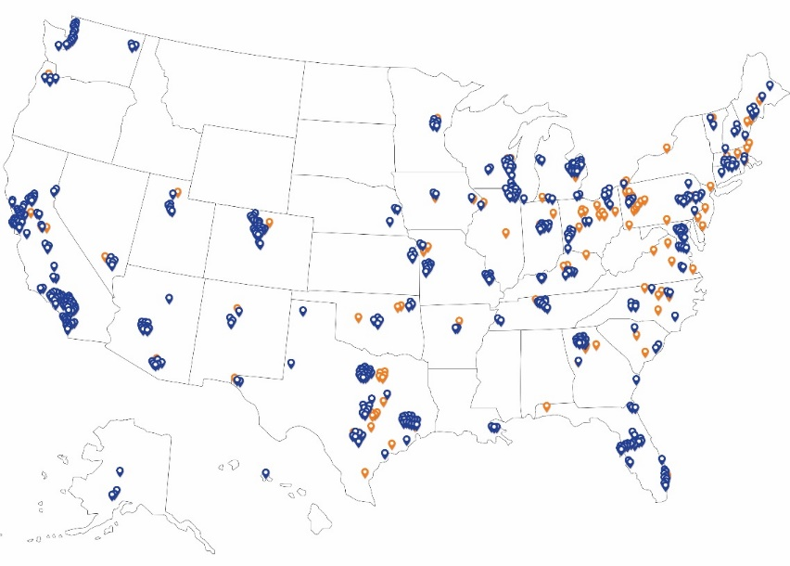
Meet Concentra
Improving the health of America’s workforce, one patient at a time
40 years of experience in occupational medicine
1-in-5 work-related injuries seen nationwide
Treated approximately 800,000 injuries in our centers in 2019
95% of injured workers seen at Concentra are recommended for return-to-work
Return-to-work and active treatment philosophy
Data-driven focus on patient experience and medical outcomes
Complimentary transportation for follow-up injury visits in most states
Partners with 239,000+ employers nationwide, including 85% of the Fortune 500
Medical centers
Onsite clinics
More than 520 medical centers and 120 onsite clinics

Slide 3
Meet Concentra
Services we provide
Injury Care Work injury care Physical and occupational therapy Specialty care Digital X-ray Telemedicine
Occupational Health Services DOT physicals Fit-for-duty examinations Respirator physicals and fit tests Drug and alcohol screening Injury prevention Job site analysis Industrial ergonomics COVID-19 clearance for return to work
1 million FMCSA/DOT examinations completed in 2019
Over 600,000 cases seen by Concentra Advanced Specialists (CAS)
2 million physical examinations completed in 2019
For a full list of Concentra services, visit Concentra.com or call your local Concentra medical center.

Slide 4
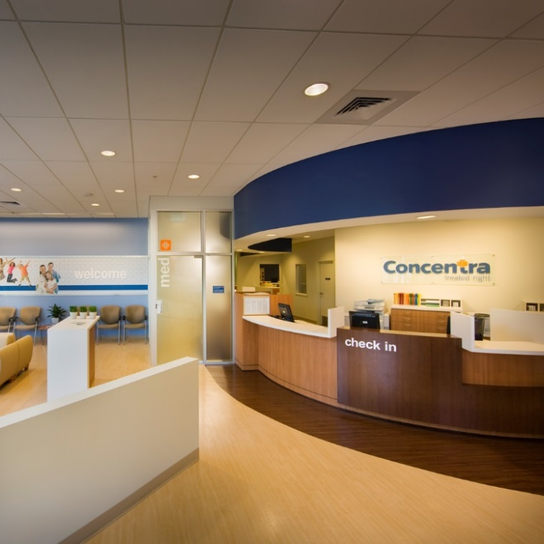
Delivering Accessible Care
Concentra medical centers with transportation service
Concentra medical centers provide walk-in work injury care, drug testing, physical exams, physical therapy, and more. Transportation services offer added convenience and speed access to care.
Concentra Medical Centers
Average 7,500 square feet
8–12 exam rooms
Onsite physical therapy
Drug testing bays
Digital X-ray
Onsite specialty care
Certified medical examiner in every center
All clinicians trained in occupational health

Slide 5
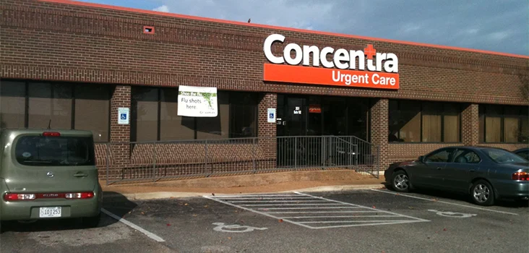
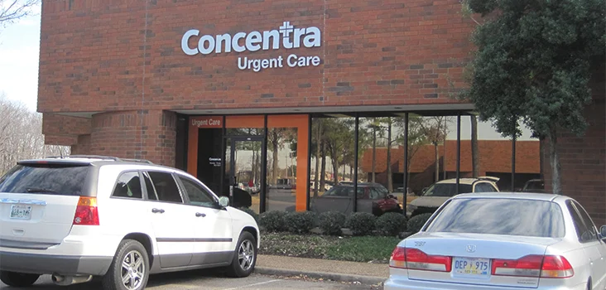
Accessing Concentra
Memphis Locations
Concentra Airport Memphis Concentra Memphis South Mendenhall Road
2831 Airways Blvd. Bldg. A Ste. 102 3965 S. Mendenhall Rd. Ste. 6
Memphis, TN 38132 Memphis, TN 38115
(901) 348-0200 (901) 365-1800
Mon-Fri 8:00 AM to 5:00 PM Monday-Friday 8:00 AM to 5:00 PM

Slide 6
Current Relationship
CMC Memphis Airport
In the last 10 months, we have performed the following…
425 Police & Fire Physicals
476 Audiograms
644 Pre-Placement Drug Screens
Treated 109 work related injuries

Slide 7
Best-in-class Occupational Medicine
A data-driven medical model
Concentra has led the occupational medicine industry for 40 years. Using that experience and third-party research, we’ve identified five keys to delivering a successful occupational medicine program:
Employer Engagement
Needs assessment and service design
Understanding the employer workplace
Patient Engagement
Welcoming facilities
One location for multiple treatments
Clear Communication
Communication packages and management reports
Direct engagement with physicians
In order to execute this model, there must be a partnership among the employer, patient, and medical provider.
Quality Medical Outcomes
Early medical intervention philosophy and outcome-focused care
Occupational medicine training and expertise
Workforce Health
Injury prevention strategies
Worker health protection

Slide 8
A History of Innovation
Onsite Clinics
A Concentra onsite clinic is a medical center built into your workplace and tailored to your business needs, budget, and culture. It can help you increase productivity, reduce health care costs, and improve workplace safety.
Transportation
We want it to be easy for your employees to get care when they need it. To help with this, we now offer complimentary transportation for your injured employees. We’ll pick them up at work, drop them off at their local Concentra medical center and take them back.
FReSH
FReSH by Concentra is a new way of measuring patient progress after injury. Instead of focusing on a patient’s perception of pain, it emphasizes functional restoration – what a patient can do and how a patient is progressing – and encourages each patient to actively participate in his or her recovery.
Data Analytics and Reporting
The Concentra Compass Report® provides customers comprehensive reporting that offers actionable information on work comp injury frequency, case duration, and costs. No other occupational medicine provider has collected sufficient data to compare outcomes and utilization data at the industry level.
OHU
Concentra’s Occupational Health University (OHU) is a program for our medical and therapy clinicians to better understand the occupational health field and best practices for the care of injured employees. It offers a methodical and challenging curriculum path to guide clinicians’ professional growth in this unique field.
Telemedicine
Concentra Telemed is a telemedicine solution delivering medical care for initial work-related injuries and rechecks. Physical therapy is also provided through Concentra Telerehab.

Slide 9
Concentra Telemed:
Speed injured employees’ access to care
Concentra Telemed® was introduced in 2017 as the first telemedicine platform designed for the treatment of work-related injuries and illnesses. Since that time, employers and employees nationwide have trusted Concentra Telemed clinicians to provide the right care at the right time – forever changing the occupational health care landscape.
Concentra Telemed has conducted 43,000 virtual visits since inception – and we continue to expand our footprint and offerings to meet growing demand.
Available now
Alaska Arizona California Colorado Connecticut Delaware Florida Georgia Hawaii Illinois | Indiana Iowa Kansas Kentucky Louisiana Maine Maryland Massachusetts Michigan Minnesota | Missouri Nebraska New Hampshire New Jersey New Mexico North Carolina Ohio (Self Insured) Oklahoma Oregon | Pennsylvania Rhode Island South Carolina Tennessee Texas Utah Vermont Virginia Washington Wisconsin

Slide 10
About Concentra Telemed:
Immediate attention for minor medical issues
Concentra Telemed is designed to provide immediate attention for minor medical issues. Serious injuries — or injuries that need hands-on care, like stitches — will still need to be seen in person by a clinician.
When to use Concentra Telemed
Grade I and II upper and lower extremity strains/sprains
First degree burns
Back strains/sprains (without significant limitations)
Neck strains/sprains (without significant limitations)
Contusions (without deformity)
Partial thickness abrasions
Contact occupational dermatitis (rashes)
Tendonitis/repetitive-use injuries
Bloodborne pathogen exposures

Slide 11
About Concentra Telerehab:
Bring physical therapy to injured employees at work or at home
Concentra Telerehab® is part of the Concentra Telemed platform
Brings physical therapy directly to the employee at work or home
Therapists have expertise evaluating work injuries and delivering care specifically via virtual platform
Available in states where Concentra currently provides telemedicine*
Operating hours Monday through Friday, between 8 a.m. – 5 p.m. (By appointment with referral from Concentra Telemed medical clinician)

Slide 12
About Concentra Telemed:
Focused on early and sustainable return to work
Concentra Telemed Injury Volume and Distribution
Leading-edge outcomes
Medical Utilization: Avg. MD Visits
2.0 Visits
Average Case Duration (Days)
8
Days
Percentage of Cases Recommended for Return to Work
83%*
Top-tier utilization and satisfaction
Patient Resource
85% using mobile 15% using computer
Satisfaction Rates 20,548 surveys 38% responded
4.6 out of 5 average rating
*A higher number of COVID-19 cases increases the percentage of off-duty cases.
YTD Q3 2020

Slide 13
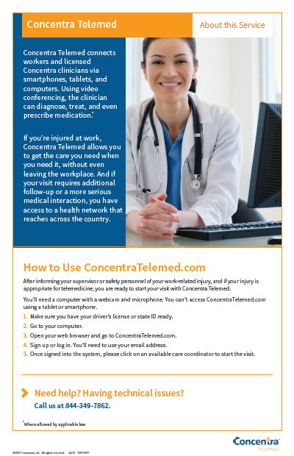
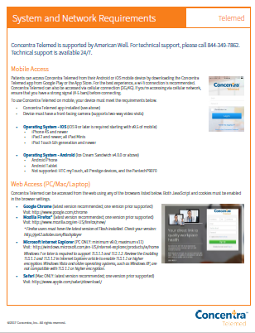
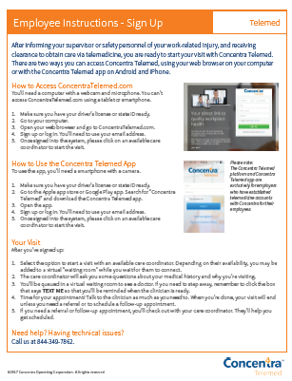
Getting Started:
Engage your employees with educational videos and materials
Questions to consider
What is my plan to communicate this new service to my organization?
What device (i.e., smartphone, tablet, computer) will my employees use to access Concentra Telemed?
Where can my employees go for a private telemedicine visit?
Does my population have a working email address, and if not, how can they get one so they can receive care?
Resources
Concentra Telemed demo video
Concentra Telerehab demo video
Telemedicine Starter Kit
General guidelines, FAQs
Step-by-step instructions for employees
Available at www.concentra.com/telemedicine
Engage your employees with educational videos and materials

Slide 14
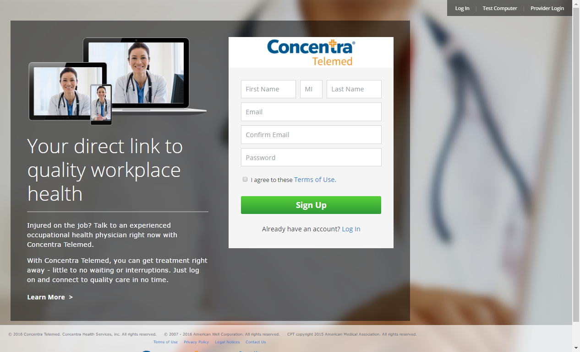
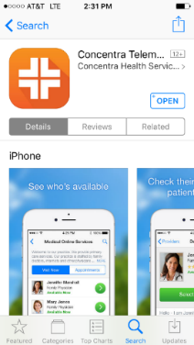
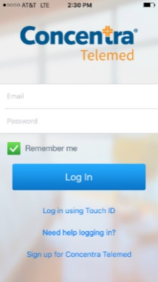
Getting Started:
Your employees access care from anywhere, anytime
Tips for virtual visits:
Employees need a quiet, private location for the visit.
They will need a computer, smartphone, or mobile device with a webcam and microphone.
An internet connection is required.
Desktop/laptop – www.concentratelemed.com
Tablet/smartphone – Download the Concentra Telemed app via the Apple App Store or Google Play.
We recommend using Google Chrome for the best experience.
Employees will need an active email address and create a password.
When the visit starts, employees will present a valid photo ID or driver’s license.
Support:
Employers and employees can contact telemed@Concentra.com for technical support and to address any questions on care delivery, case process, etc.

