Slide 1


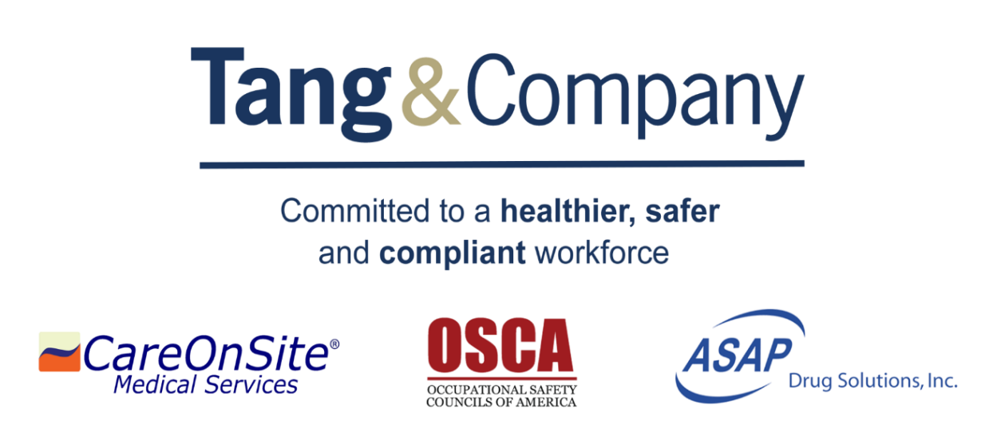

Slide 2

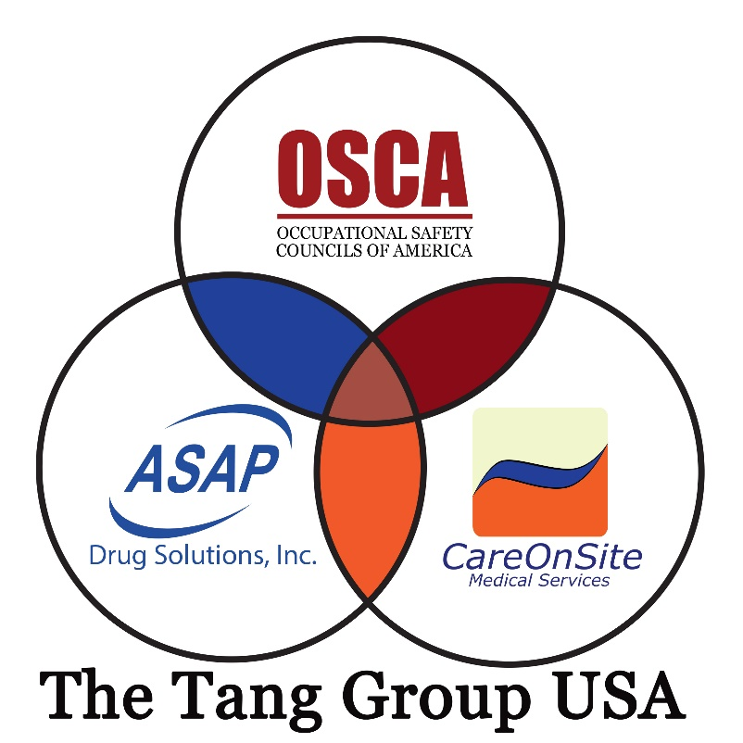
CUSTOM CBT DEVELOPMENT
COMPUTER BASED TRAINING
ONLINE OR IN LAB
INSTRUCTOR LED CLASSES
DATA MANAGEMENT
DRUG & ALCOHOL TESTING
D.O.T. POLICY ADMINISTRATION
COMPANY POLICY ADMINISTRATION
RECORD KEEPING
ROSTER MANAGEMENT
HAIR & ORAL FLUID TESTING
IN-HOUSE MRO
24-HOUR INJURY CARE
TELEMEDICINE
TELEPHONIC NURSE TRIAGE
MEDICAL ONSITE STAFFING
CASE MANAGEMENT
MEDICAL COMPLIANCE TESTING
LICENSED IN ALL 50 STATES

Slide 3

Workforce Screening Services

Slide 4

ASAP Drug Solutions
40 years of industry experience and knowledge
In-house MROs (physician-owners/founders)
In-house compliance department
Second largest third-party administrator (TPA) in the country
Exclusive TPA for the Los Angeles Clean Card (LACC) since 1998
Over 3,000 collection sites nationally
Live customer service available 7/24/365
Consolidated/customized billing – by work location, job #, P.O. #, etc..
Comprehensive drug and alcohol testing programs:
  Department of Transportation (DOT) regulations
  Corporate (Company) policies – Custom, standard, etc..
  Consortium policies – LACC,ASAPCC,NASAP, etc..
Customized background screening and employment verification
Numerous industry certifications and accreditations: ISO 9001, ISO 14001, OHSAS 18001, DATIA(TPA),etc.
National Coverage

Slide 5
Trusted by Customers
Customized, credible, and confidential Drug and Alcohol testing and Background screening
Secure, state of the art, proprietary web-based database with convenient 24/7 access
Solution-oriented customer support
Real-time contractor and employee tracking access
Management of the entire employee screening process.
D/A and Safety training through OSCA
Advancing excellence in the screening, compliance, and safety industries

Slide 6

Occupational Health Services

Slide 7

CareOnSite
A Premier Occupational Healthcare Services Company
Excellence in Healthcare Delivery
  Sine Qua Non – “Absolutely necessary”
  Compassionate care when it matters most
Unparalleled Expertise & Experience
  Nearly 40 years of Occupational Health Experience - Drs. Brian and Helen Tang
  Physicians licensed in 50 states
  Board-certified Physicians in Occupational Medicine, Internal Medicine, Emergency Medicine, Orthopedics, Radiology and Clinical Faculty at UCLA
  Services are available 24/7/365
Cost-Effective and Cost Savings
    Work within clients’ budgetary constraints to trim unnecessary waste, optimize efficiency
    Understanding of metrics, value of outcomes-reduce unnecessary OSHA recordable injuries
    Keep cases in house and reduce workers comp costs

Slide 8
Different Modalities to Deliver THE BEST Care
COS® Long Beach and Martinez (Brick & Mortar)
COS® Telephonic Nurse Triage Program
COS® On-Site Medical Staffing
Telemedicine Program
Direct-To-Provider (DTP) Case Management
Medical Surveillance Program Database

Slide 9






























Clients and Industries
Petrochemical
Public Utilities
Manufacturing
Construction
Renewable Energy
Nuclear
Healthcare

Slide 10
Telemedicine Training Video
https://www.youtube.com/watch?v=tRnNcrn6UAg&feature=youtu.be
Notes:
Many other occupational providers provide telephonic services – CareOnSite provides telemedicine (audiovisual) services.

Slide 11
CareOnSite: Telemedicine Demonstration

Slide 12

Computer-Based Training

Slide 13

OSCA Overview
Founded in 2003, OSCA was formed at the request of our petrochemical customers to deliver high quality safety training to the contractors working in their facilities.
Customized, computer-based training development & orientations
Training for General Industry, Petrochemical Industry & Construction Safety
Medical compliance services (respirator fit, audiograms, pulmonary function, etc.)
  All services tie into online database management for easy organization, tracking & audit (training, medical compliance, drug & alcohol testing)

Slide 14
OSCA: Results
Delivering a Safer and Better Educated Workforce
Provided site and safety orientation to more than 200,000 employees and contractors in past 14 years
Created and delivered over 750,000 CBT training units for leading manufacturing and petrochemical industries
Facilitated over 250,000 students in instructor led classes providing company and industry lessons and assessments

Slide 15
OSCA: CBT Advantages for the Employee
It can lead to increased retention and a Stronger grasp on the subject because of the many elements that are combined in e-learning to reinforce the message, such as video, audio, quizzes, interactive exercises
In addition, CBT provides interactive exercises with which learners can test their knowledge, practice applying the skills acquired and experiment with what they have learned in a safe, nonjudgmental environment.

Slide 16
OSCA: CBT Advantages for the Employer
It provides a consistent message
Convenient, any location at any time
Updated quickly and easily
Elimination of costs such as travel, training facilities, hotel rooms, meals, trainers and employee time off work while travelling and attending training.

Slide 17


We appreciate you as our ASAP Client and want to say thank you for everything you do!

