Slide 1

City of Memphis
2020 Wellness Program and Resources
June 26, 2020 Safety Fair
Notes:
Transition into demo…

Slide 2
DISCLAIMERS:
The material contained within this presentation is intended to help you make good health choices. It should not be interpreted as medical advice. If you have specific medical questions, consult your health care provider.
Actual benefit changes are updated over time, so webinar information could become outdated. You should always check with your human resources department for the most up-to-date information.
Notes:
The software improves how companies collect, manage and act on employee ideas that align to our priorities. Founded in 2010 in Canada, it was first used to

Slide 3
Earn Money
For
Making Healthy Choices
Notes:
Transition into demo…

Slide 4
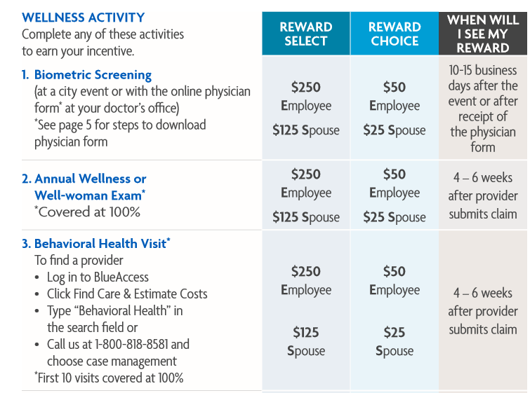
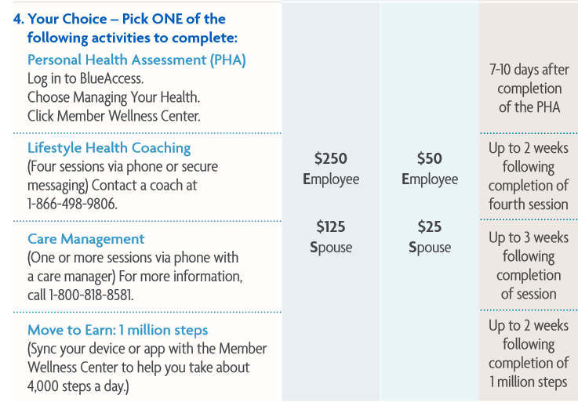
Please review your 2020 Member Guide for detailed information!
2020 Rewards
Notes:
The software improves how companies collect, manage and act on employee ideas that align to our priorities. Founded in 2010 in Canada, it was first used to

Slide 5

2020 Rewards Deadline Extended
Deadline to earn and redeem your Rewards has been extended
Complete your activities by 12/31/2020
Redeem your Rewards by 2/28/2021
Note: The deadline to remove the tobacco surcharge is still 10/31/2020
Notes:
The software improves how companies collect, manage and act on employee ideas that align to our priorities. Founded in 2010 in Canada, it was first used to

Slide 6

Getting Started: Register for BlueAccess
Visit bcbst.com and follow these steps:
  Choose the “Register Now” option
  Select the first option: Register as a Member
  You’ll need your Member ID card to sign up
Login with your username and password if you already registered
If you have any issues logging in give us a call anytime 1-888-796-0609.
Notes:
The software improves how companies collect, manage and act on employee ideas that align to our priorities. Founded in 2010 in Canada, it was first used to

Slide 7
2020
Wellness Resources
Notes:
Transition into demo…

Slide 8

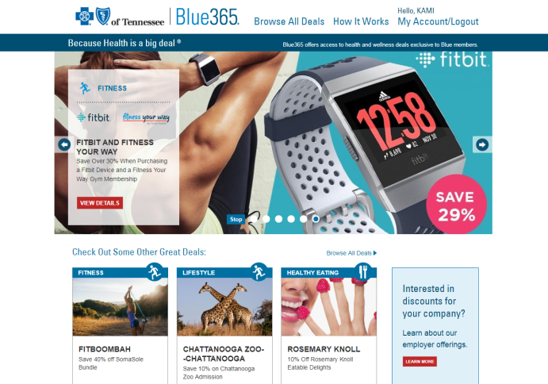
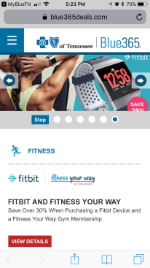
Blue365® Member Discounts
Making healthy living easy and affordable
Find your exclusive discounts at bcbst.com
Discounts include:
Gym memberships
Fitness gear
Healthy eating options
National nutrition programs
Vision products and services
Personal care
Financial products
Notes:
The software improves how companies collect, manage and act on employee ideas that align to our priorities. Founded in 2010 in Canada, it was first used to

Slide 9


Fitness Your WayTM
Get fit at a gym that works for you
Easily find fitness centers and enroll at bcbst.com
Program features:
Access to over 10,000 gyms nationwide*
Locate gyms and enroll online
One-time enrollment fee of $29
Membership is $29/month per person
No long-term contract – only a 3 month initial commitment
Notes:
The software improves how companies collect, manage and act on employee ideas that align to our priorities. Founded in 2010 in Canada, it was first used to

Slide 10
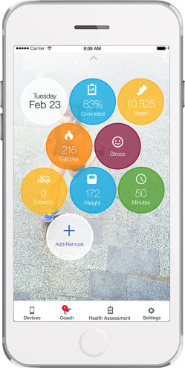
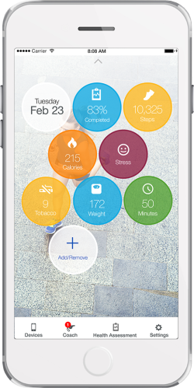
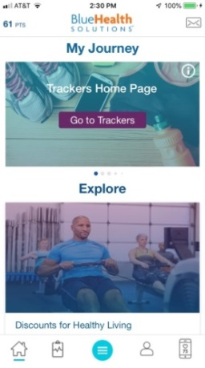
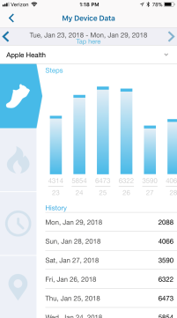
AlwaysOn Mobile App
Use your wellness resources anytime with the AlwaysOn mobile app
Tools include:
Personal Health Assessment
Health Trackers
Device and App Integration
Lifestyle Health Coaching
Available in Apple Store and Google Play
Notes:
The software improves how companies collect, manage and act on employee ideas that align to our priorities. Founded in 2010 in Canada, it was first used to

Slide 11

Healthy Maternity
Educating, empowering, and supporting moms-to-be
Program features:
Self-enrollment online or by phone
One-on-one support from a maternity nurse
Newborn education and immunizations standards
Help with getting the most from maternity benefits
Prenatal and post partum online resources at bcbst.com/Healthy-Maternity
Electric breast pump incentive for qualifying participants*
Learn more at bcbst.com/healthy-maternity or call 1-800-818-8581.
*Must enroll before 20 weeks of pregnancy and intend to breastfeed
Notes:
The software improves how companies collect, manage and act on employee ideas that align to our priorities. Founded in 2010 in Canada, it was first used to

Slide 12

PhysicianNow
Convenient, cost-effective alternative to care - $0 Co-Pay
Call 1-888-283-6691 or log in to bcbst.com
Use PhysicianNow for:
Allergies
Respiratory issues
Cold and flu
Fever*
Sore throat
Sinus infections
Urinary tract infections
Skin conditions
(rashes or insect bites)
Depression
Stress
Anxiety
Notes:
The software improves how companies collect, manage and act on employee ideas that align to our priorities. Founded in 2010 in Canada, it was first used to

Slide 13

Nurseline
Peace of mind is a phone call away
Call the Nurseline at 1-800-818-8581
Program features:
Nurses are available 24/7/365
Members can call or connect via live online chat
No matter what the health concern - a cut finger, child’s fever, possible food poisoning, skin rash or sprained ankle - an experienced, caring nurse can help your members decide what kind of care they need
Notes:
The software improves how companies collect, manage and act on employee ideas that align to our priorities. Founded in 2010 in Canada, it was first used to

Slide 14

Lifestyle Health Coaching
Personalized coaching to help you reach your goals
Call a coach 1-866-498-9806
Program includes:
Personal health coach
Unlimited inbound calling or secure messaging to your health coach
Goal setting, guidance, and motivation
Outreach based on risk and member preference
Targeted coaching topics:
  Weight management
  Nutrition
  Physical activity
  Tobacco cessation
  Blood pressure
  Cholesterol
  Stress management
Notes:
The software improves how companies collect, manage and act on employee ideas that align to our priorities. Founded in 2010 in Canada, it was first used to

Slide 15

Chronic Care Management
Personalized advice and guidance to manage chronic conditions
Call 1-800-818-8581, option 2
Conditions include:
Asthma
Diabetes
Chronic Obstructive Pulmonary Disease (COPD)
Coronary Artery Disease (CAD)
Congestive Heart Failure
Depression
Our Care Managers:
Educate on condition/diagnosis
Address gaps in care
Help set goals for treatment and medication adherence
Locate community resources and support
Coordinate scheduling of needed services
Notes:
The software improves how companies collect, manage and act on employee ideas that align to our priorities. Founded in 2010 in Canada, it was first used to

Slide 16
Password:
BCBST
Notes:
Transition into demo…

Slide 17
Thank you
Notes:
Transition into demo…

