Slide 1


Slide 2


Slide 3


Slide 4


Slide 5


Slide 6
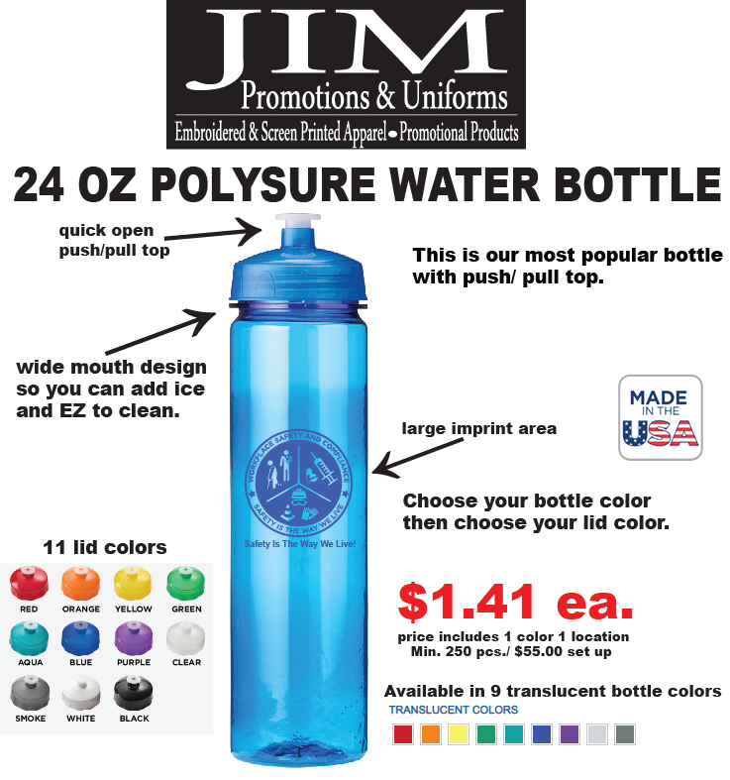

Slide 7


Slide 8
Visit us at: www.jimpromotions.com

