Slide 1


Experts in You

Slide 2

Who Are We?
World Class Orthopedics. Exceptional Patient Experience.
34 specialists delivering comprehensive personalized orthopedic care across 8 Mid-South clinics and 2 surgery centers.
Our services include:
Orthopedic Services
Physical & Occupational Therapy
Imaging and Diagnostic Services
Ambulatory Surgery Centers

Slide 3
Convenience & Accessibility
24/7 Urgent Orthopedic Care – Just call 901-261-STAT
Telemedicine, including for Physical Therapy
Book Your Appointment Online
8 Mid-South Clinic Locations

Slide 4
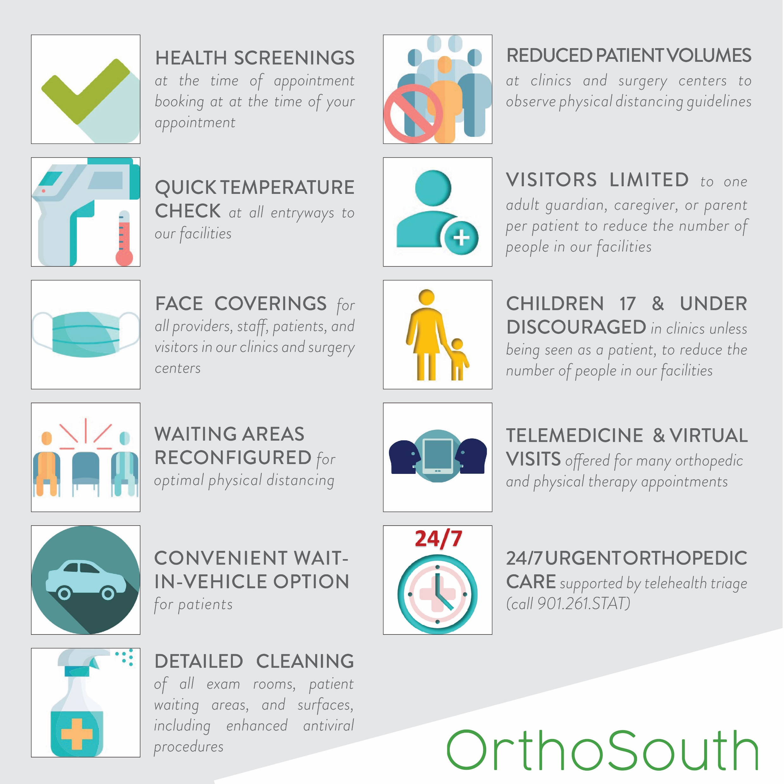
Safety. Accessibility. Convenience. Welcome Back to OrthoSouth.
As our community re-opens, we have carefully and thoughtfully increased access to our services.

Slide 5

No matter the need, we have a doctor ready to listen first, diagnose second, then work with you on a personalized treatment plan.
Elbow
Foot & Ankle
General Orthopedics
Hand & Wrist
Hip & Pelvis
Joint Replacement
Knee
Spine
Orthopedic Oncology
Physical Medicine & Rehabilitation
Regenerative Medicine
Shoulder
Spine Surgery
Sports Medicine

Slide 6
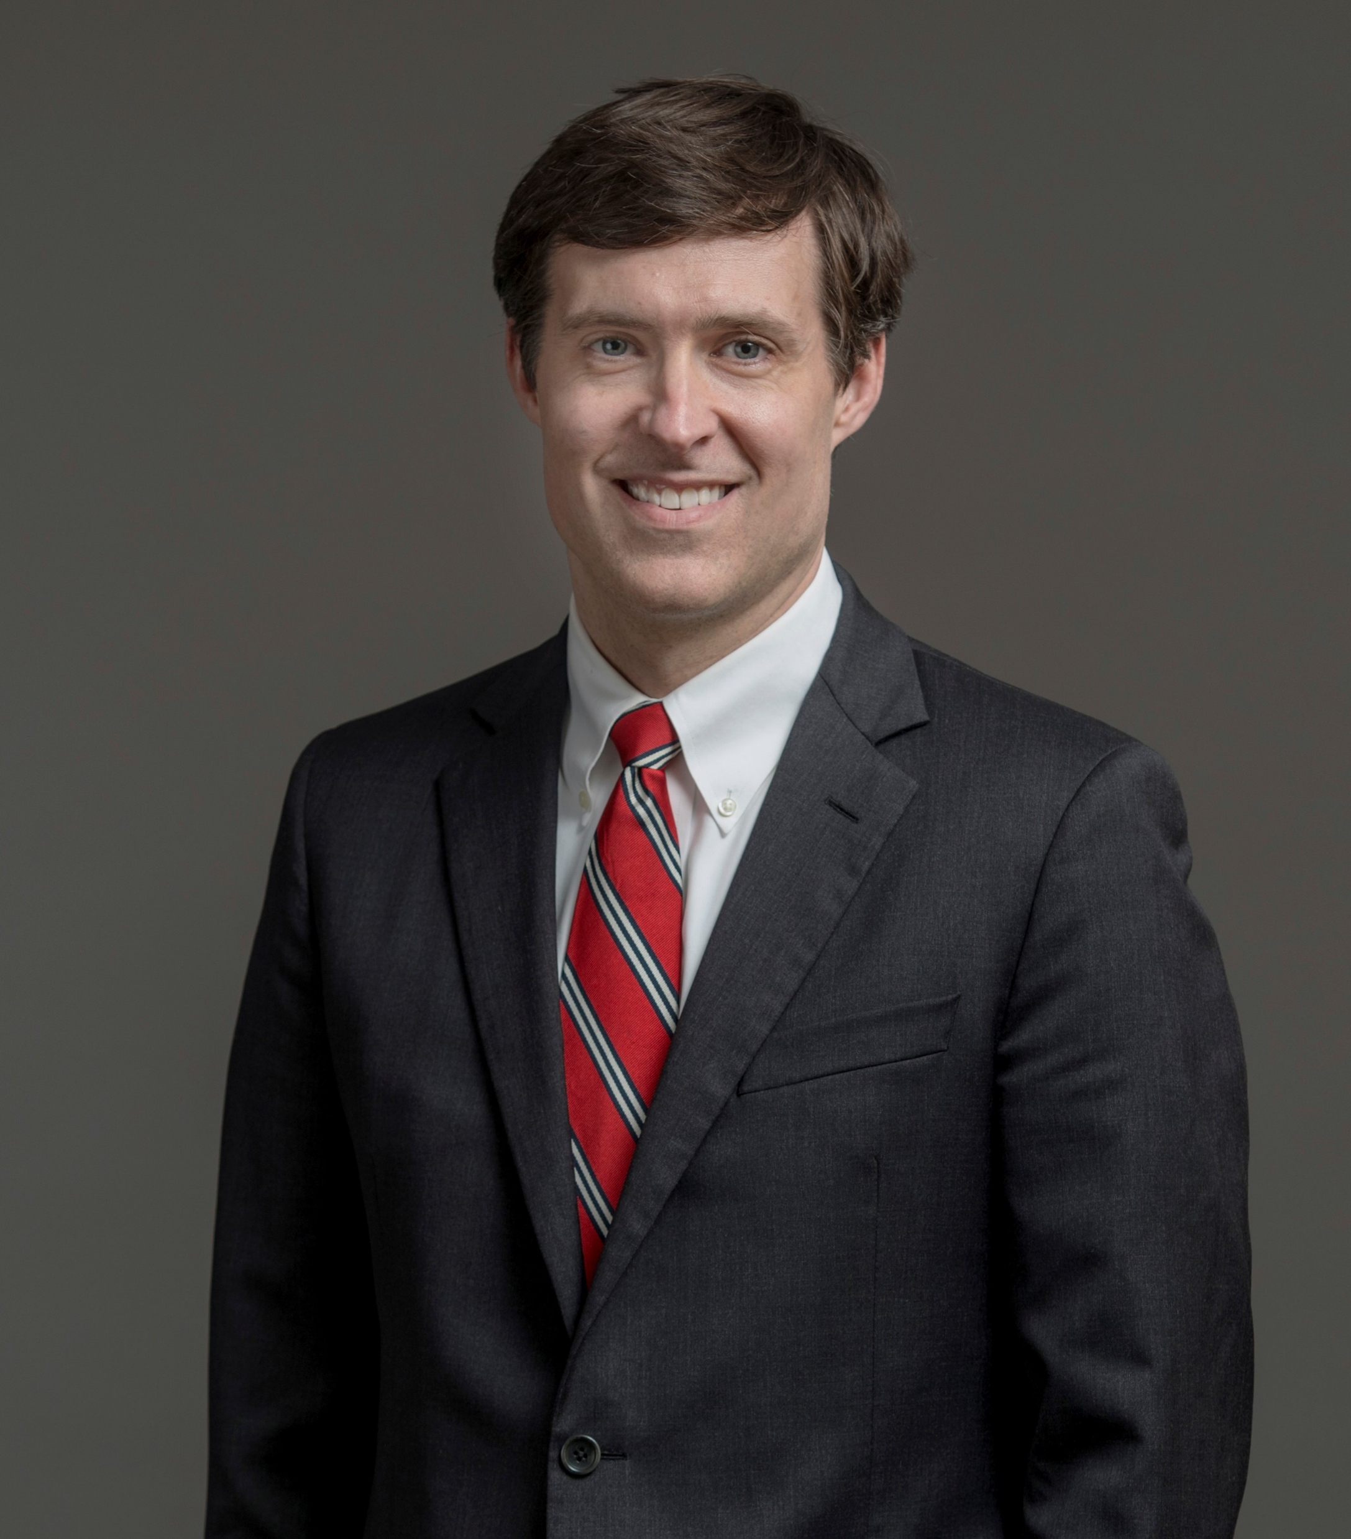
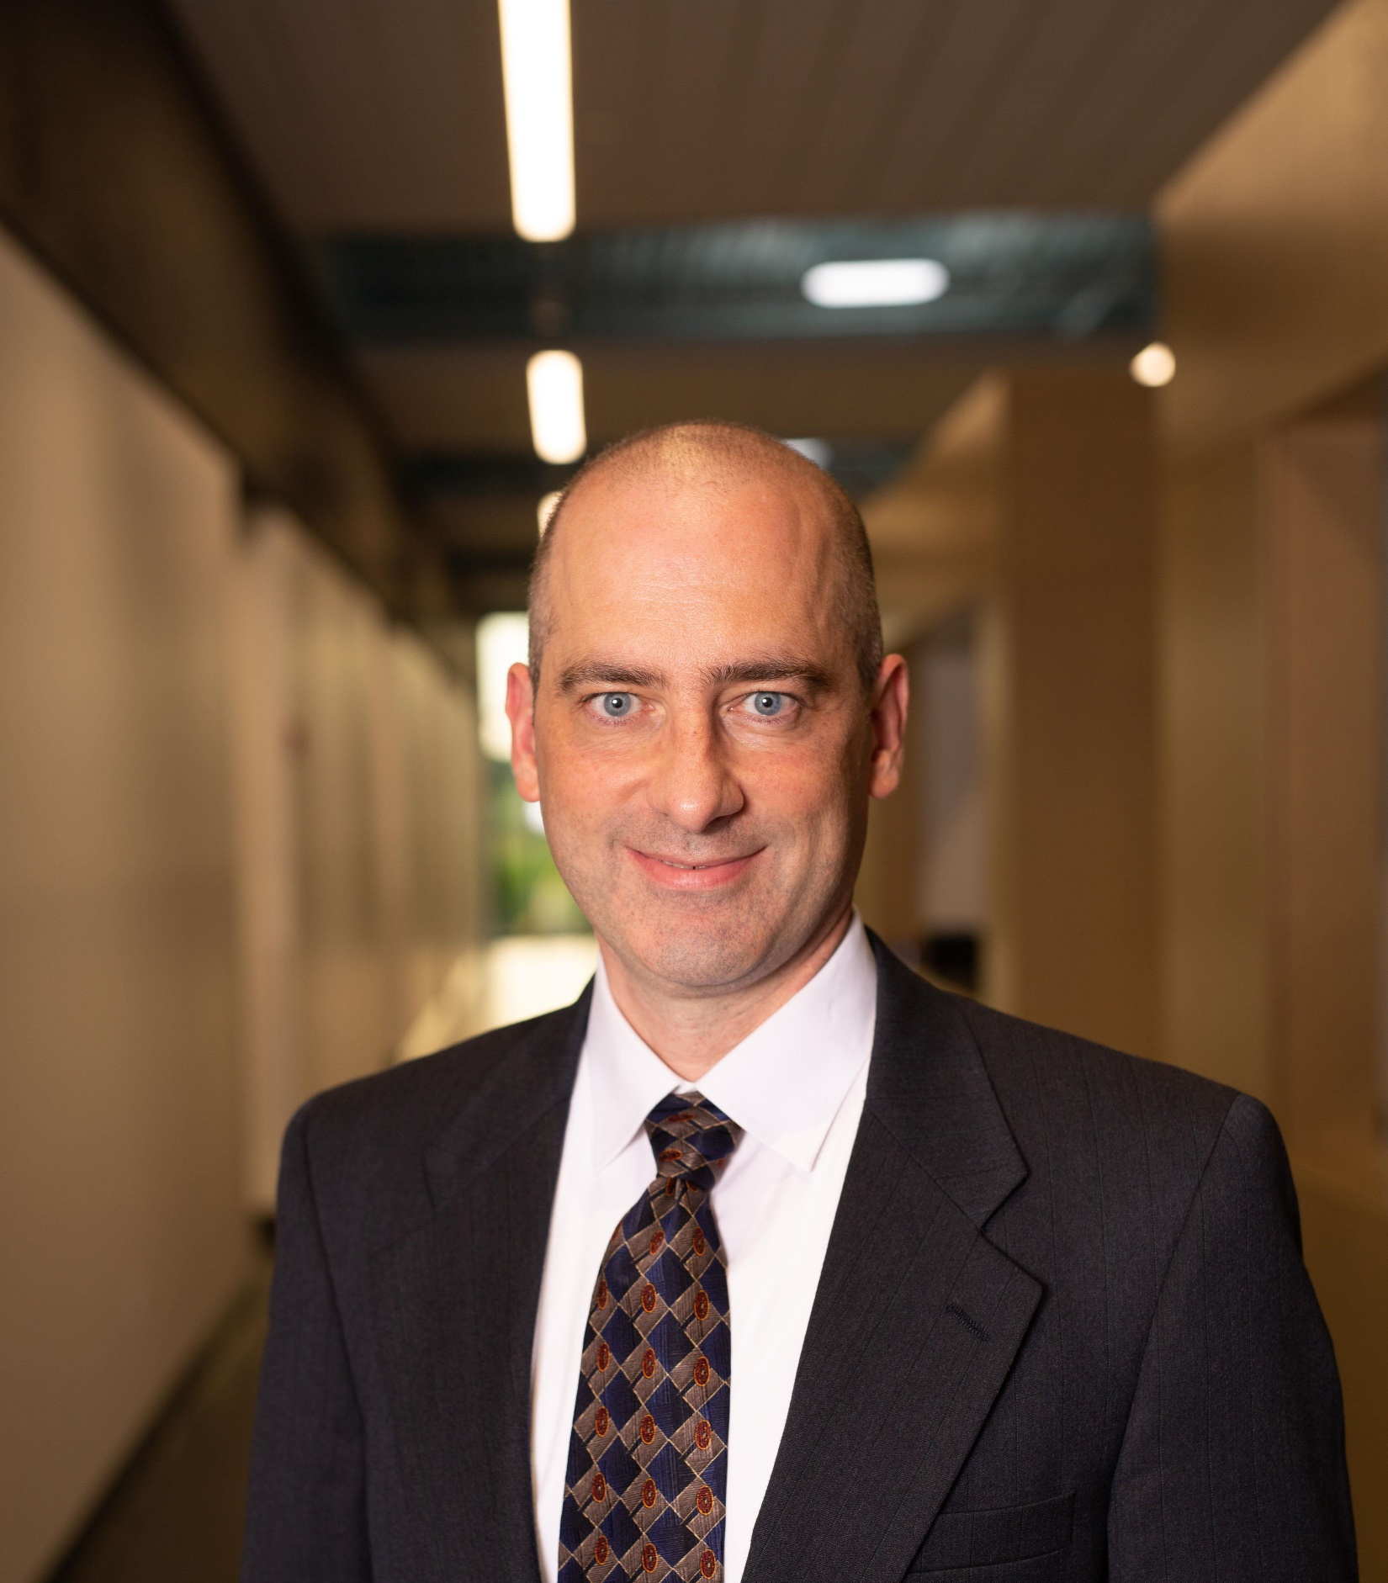
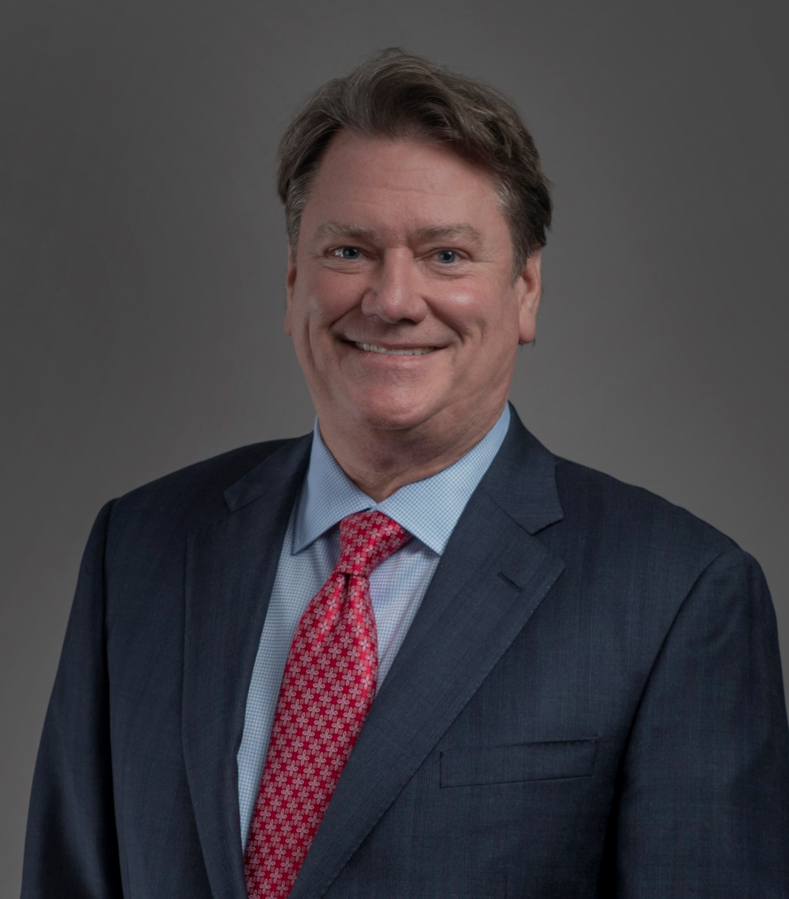
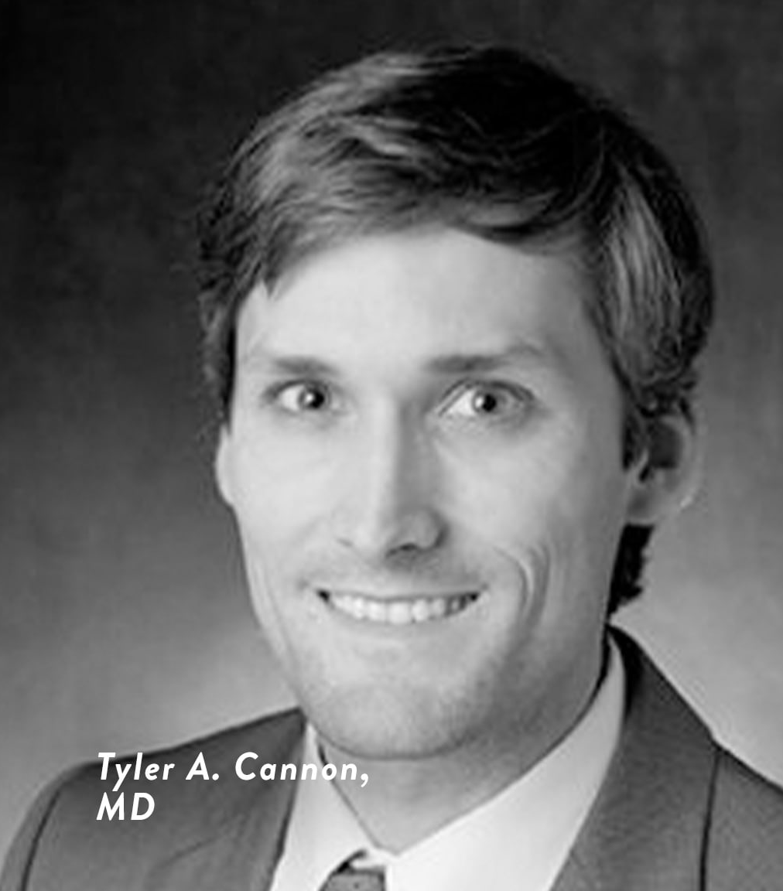
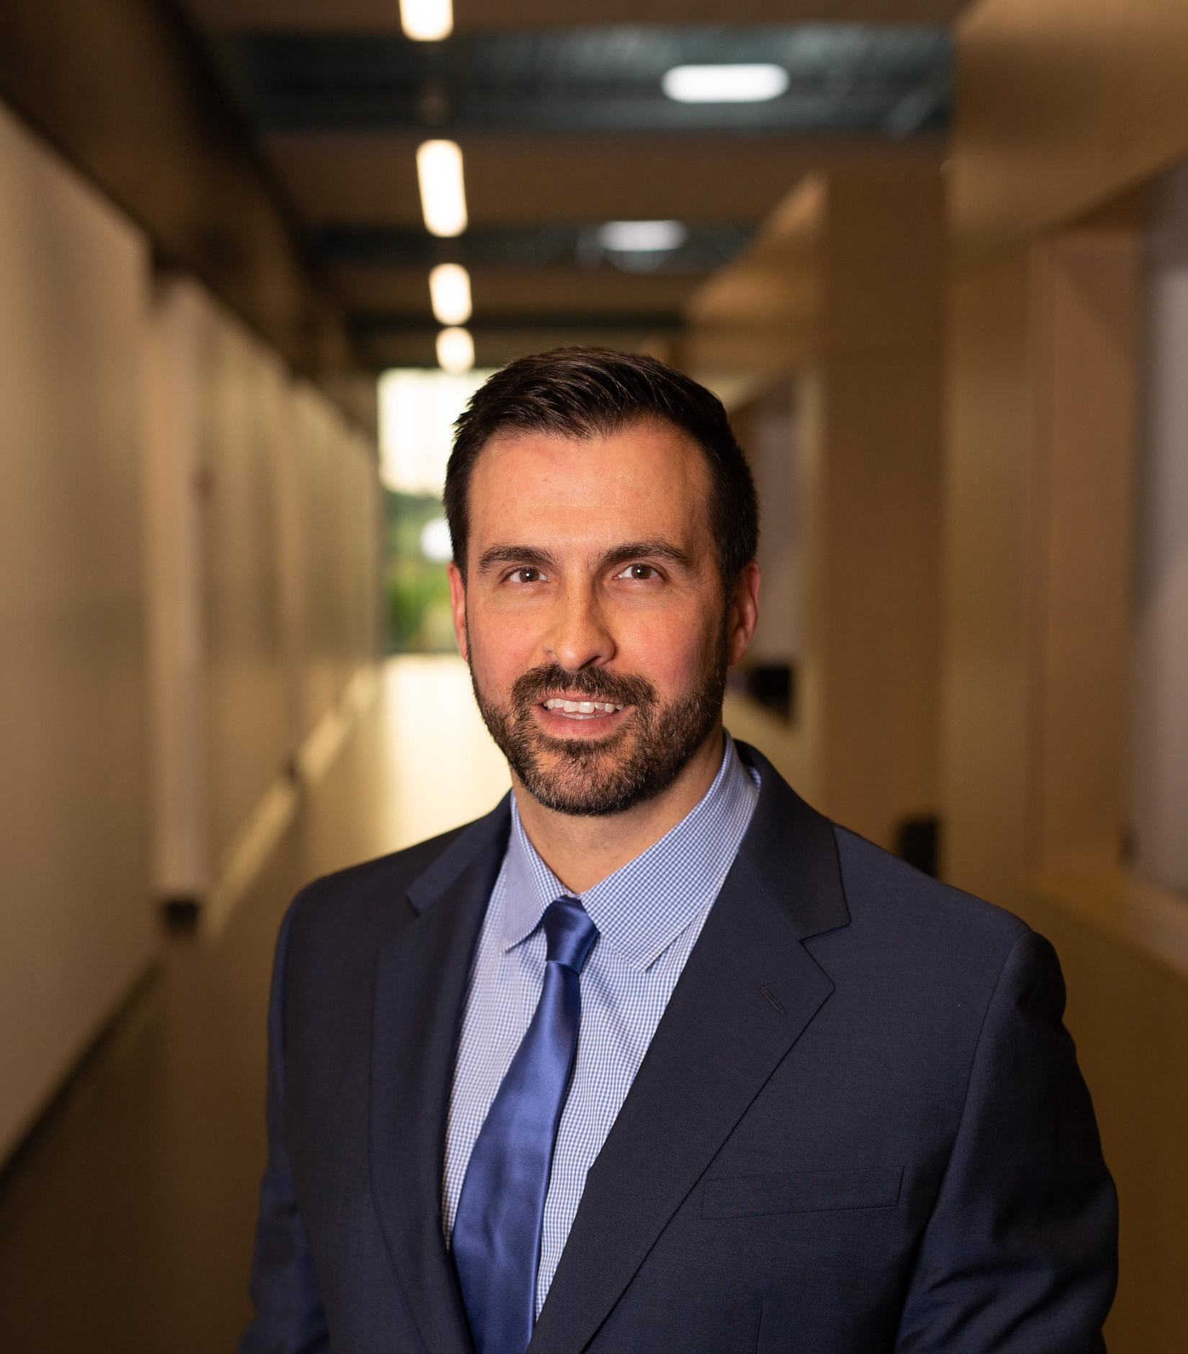
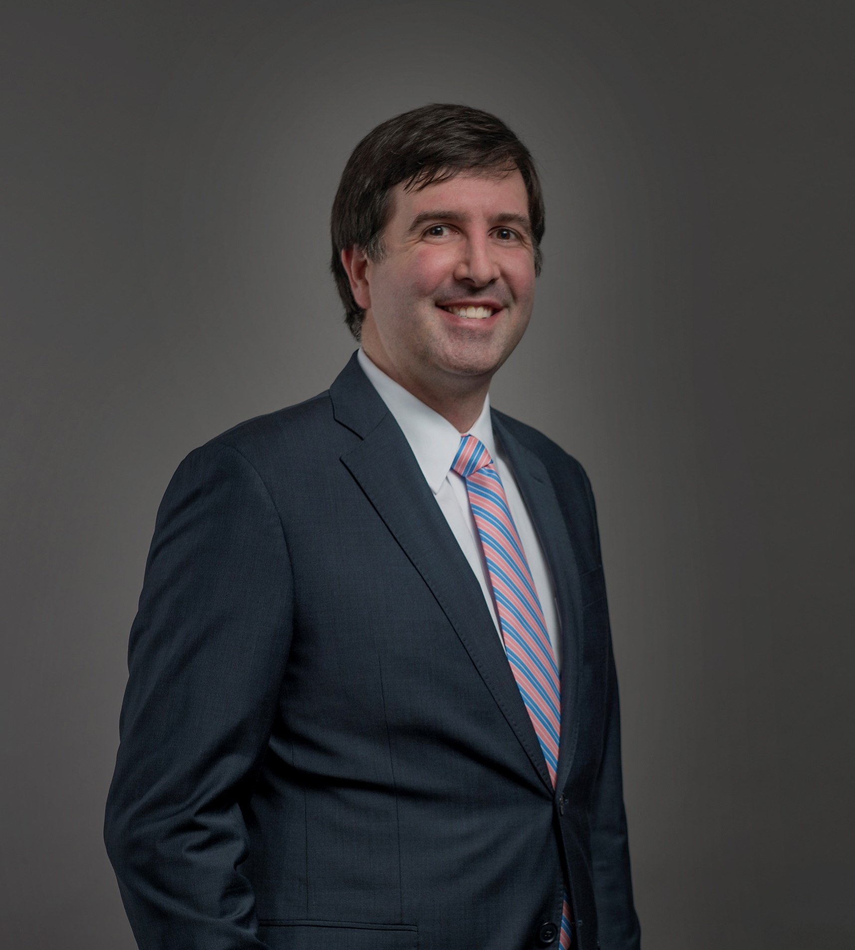
Your Personal
Hand, Wrist, & Elbow (Upper Extremity) Experts
Daniel T. Fletcher, MD
Christian Fahey, MD
R. Jeffrey Cole, MD
Tyler A. Cannon, MD
Our upper extremity specialists are available at a clinic location convenient to you. From Carpal Tunnel Syndrome, to Nerve Injuries, and everywhere in between, don’t hesitate to bring your hand/wrist or elbow pain to us for evaluation.
LEARN MORE
BOOK ONLINE NOW
Christopher Pokabla, MD
J. Barton Williams, MD

Slide 7
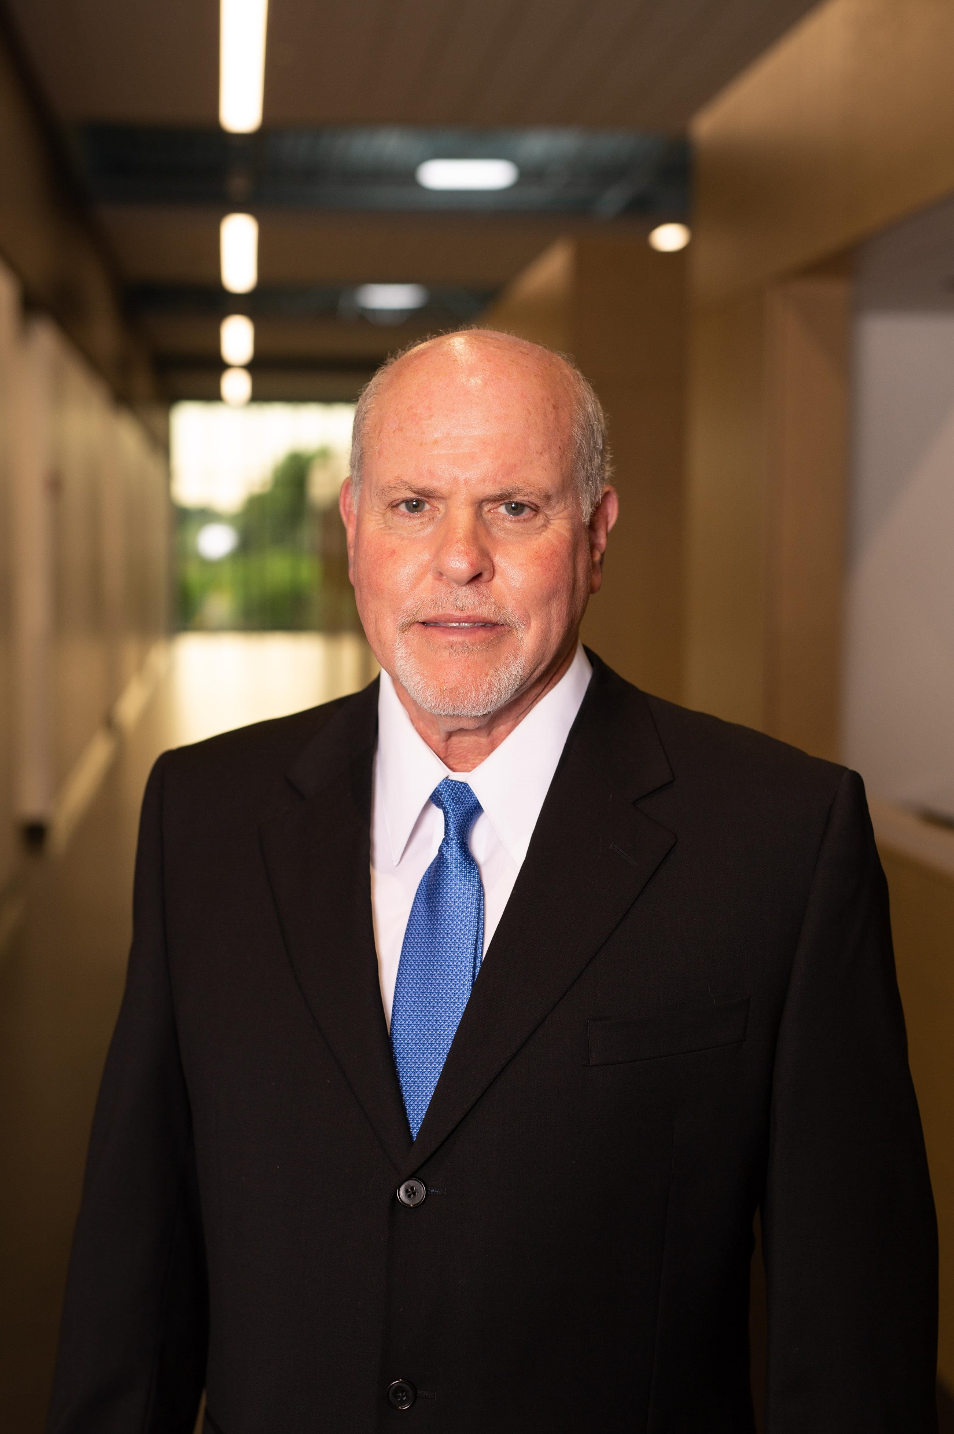
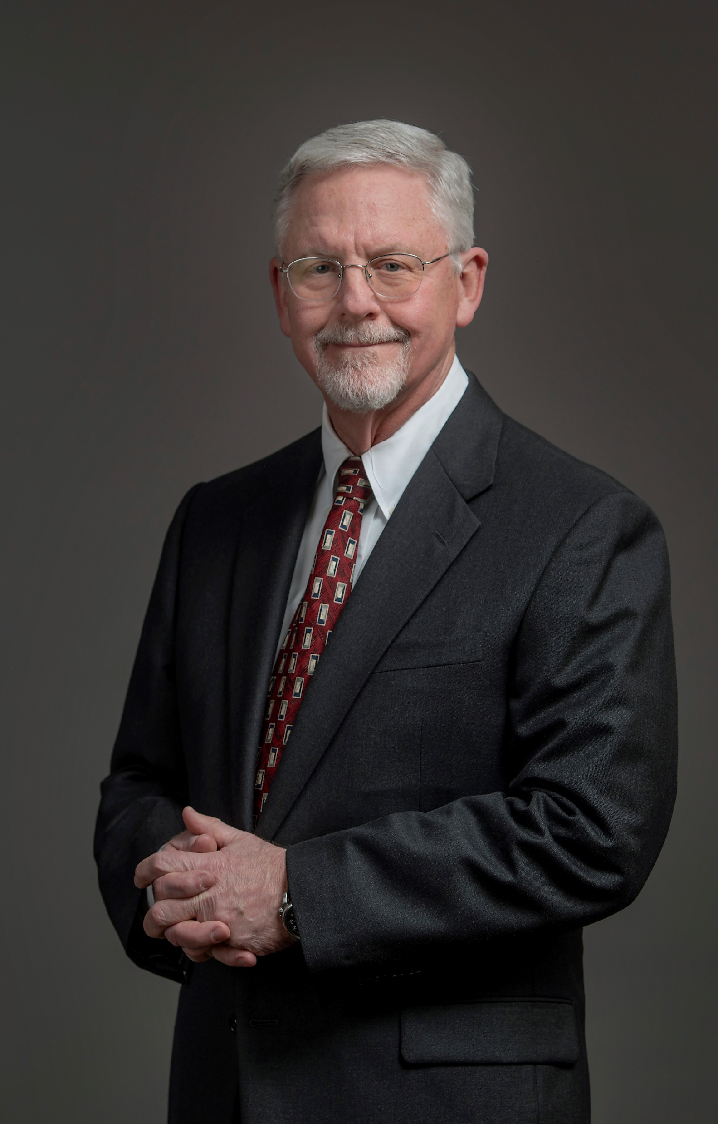
Your Personal
Foot & Ankle Experts
Foot and ankle orthopedic surgeons are medical doctors who focus on the diagnosis and treatment of injuries, diseases, and other conditions of the foot and ankle. OrthoSouth foot and ankle surgeons have completed five years of orthopedic surgical residency training, and Dr. Jameson has completed additional fellowship training dedicated to treatment of foot and ankle disorders.
Marvin Leventhal, MD
W. Dean Jameson, MD
LEARN MORE
BOOK ONLINE NOW

Slide 8
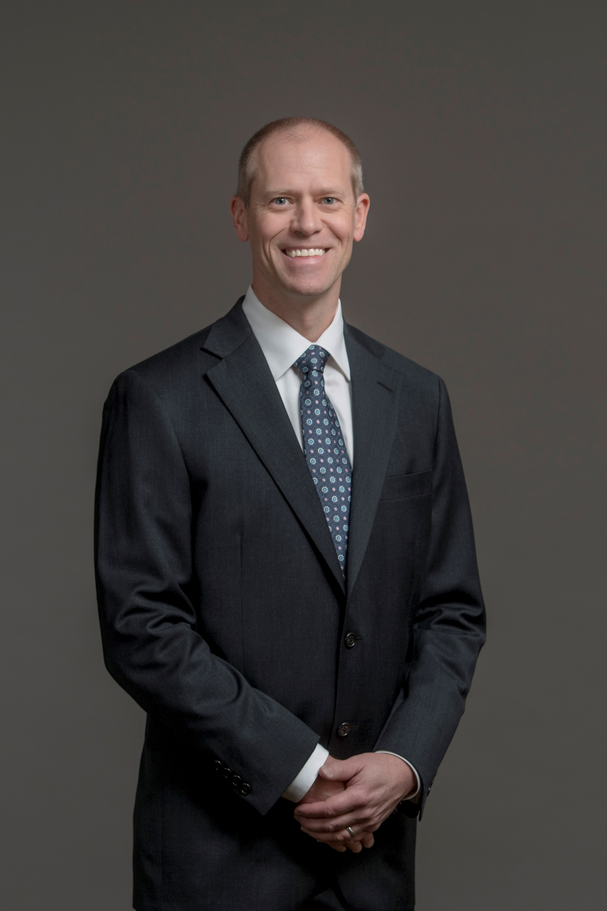

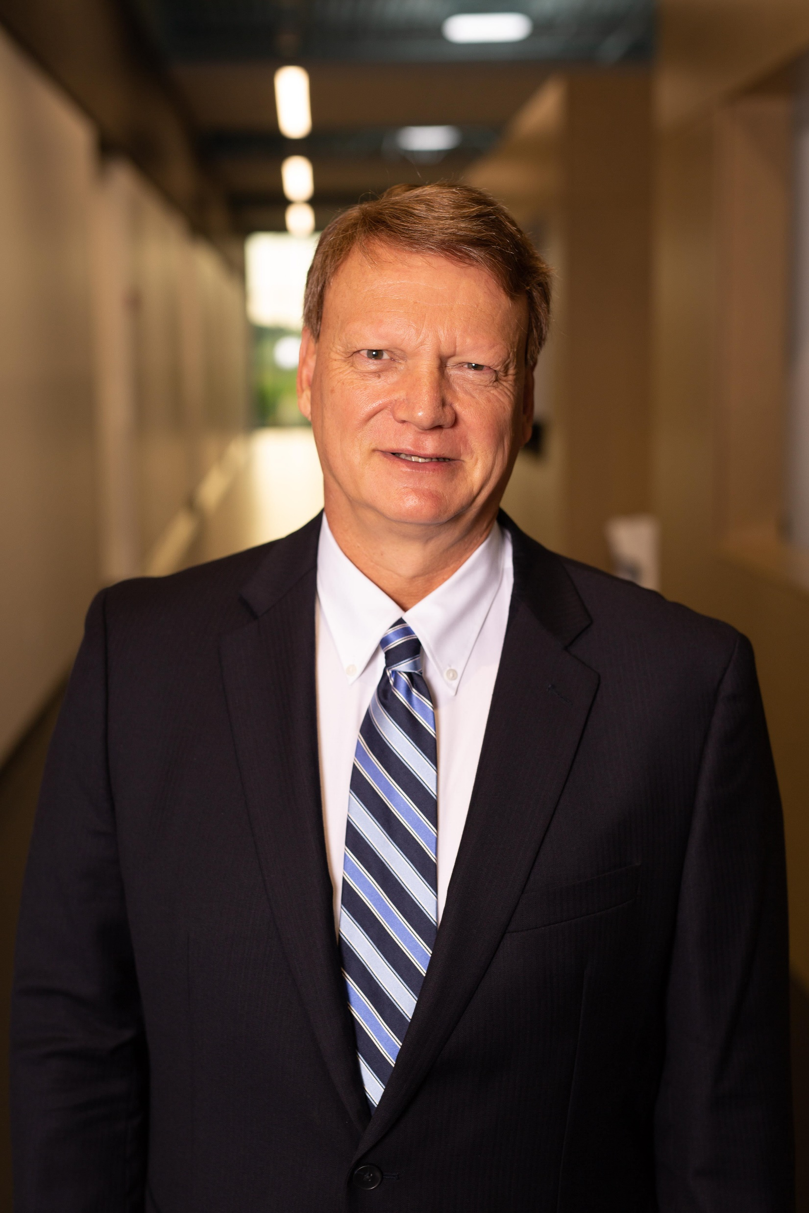
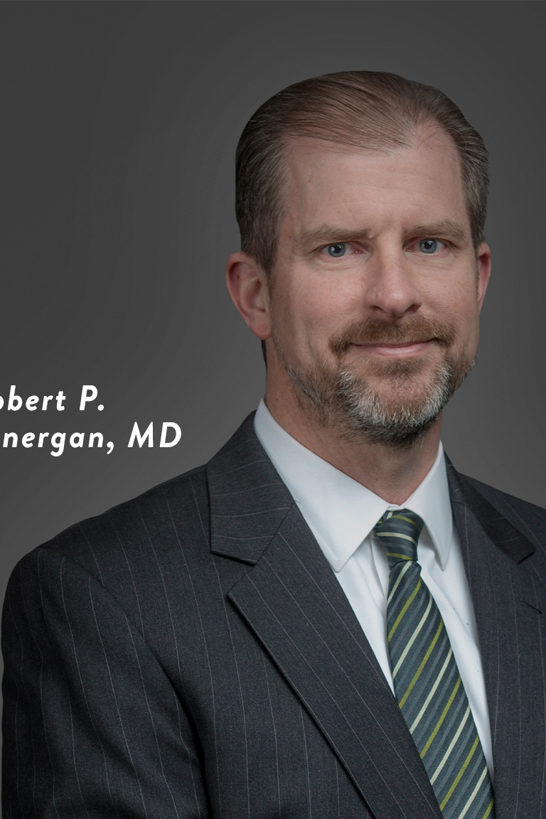
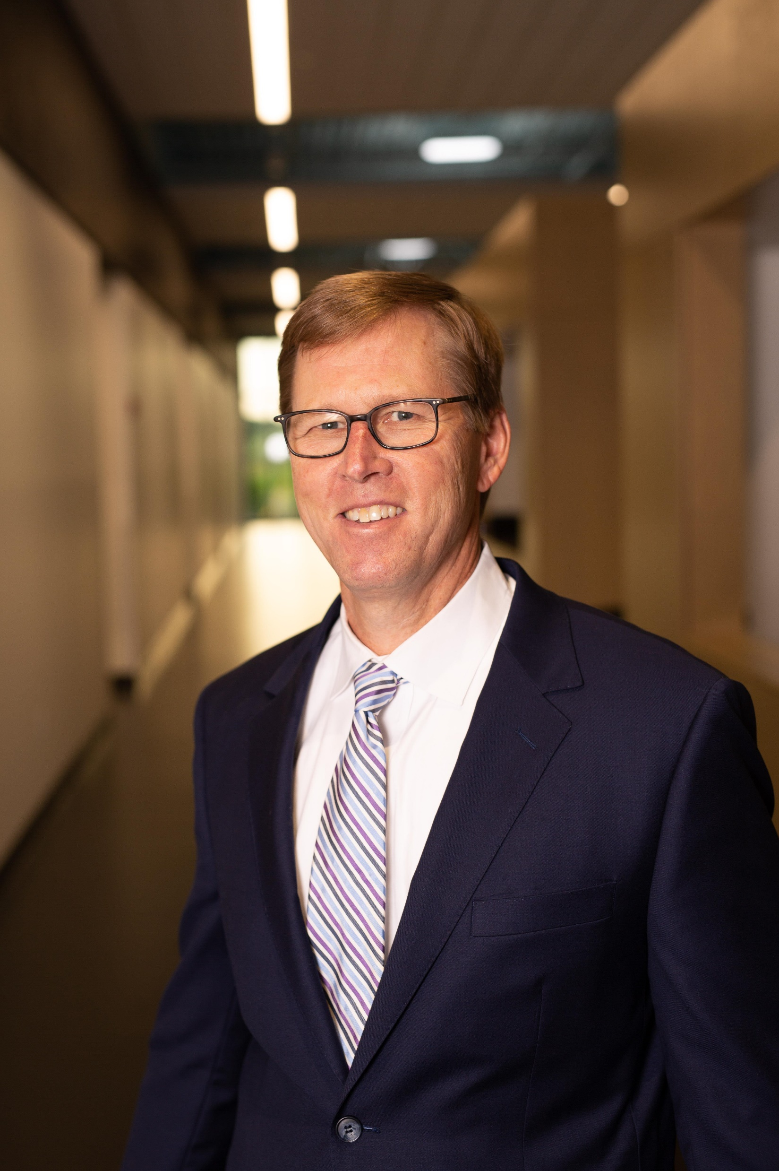
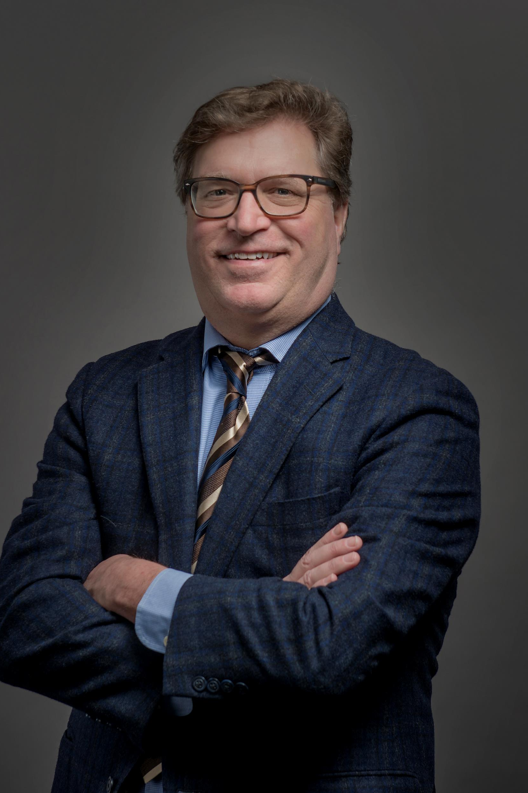
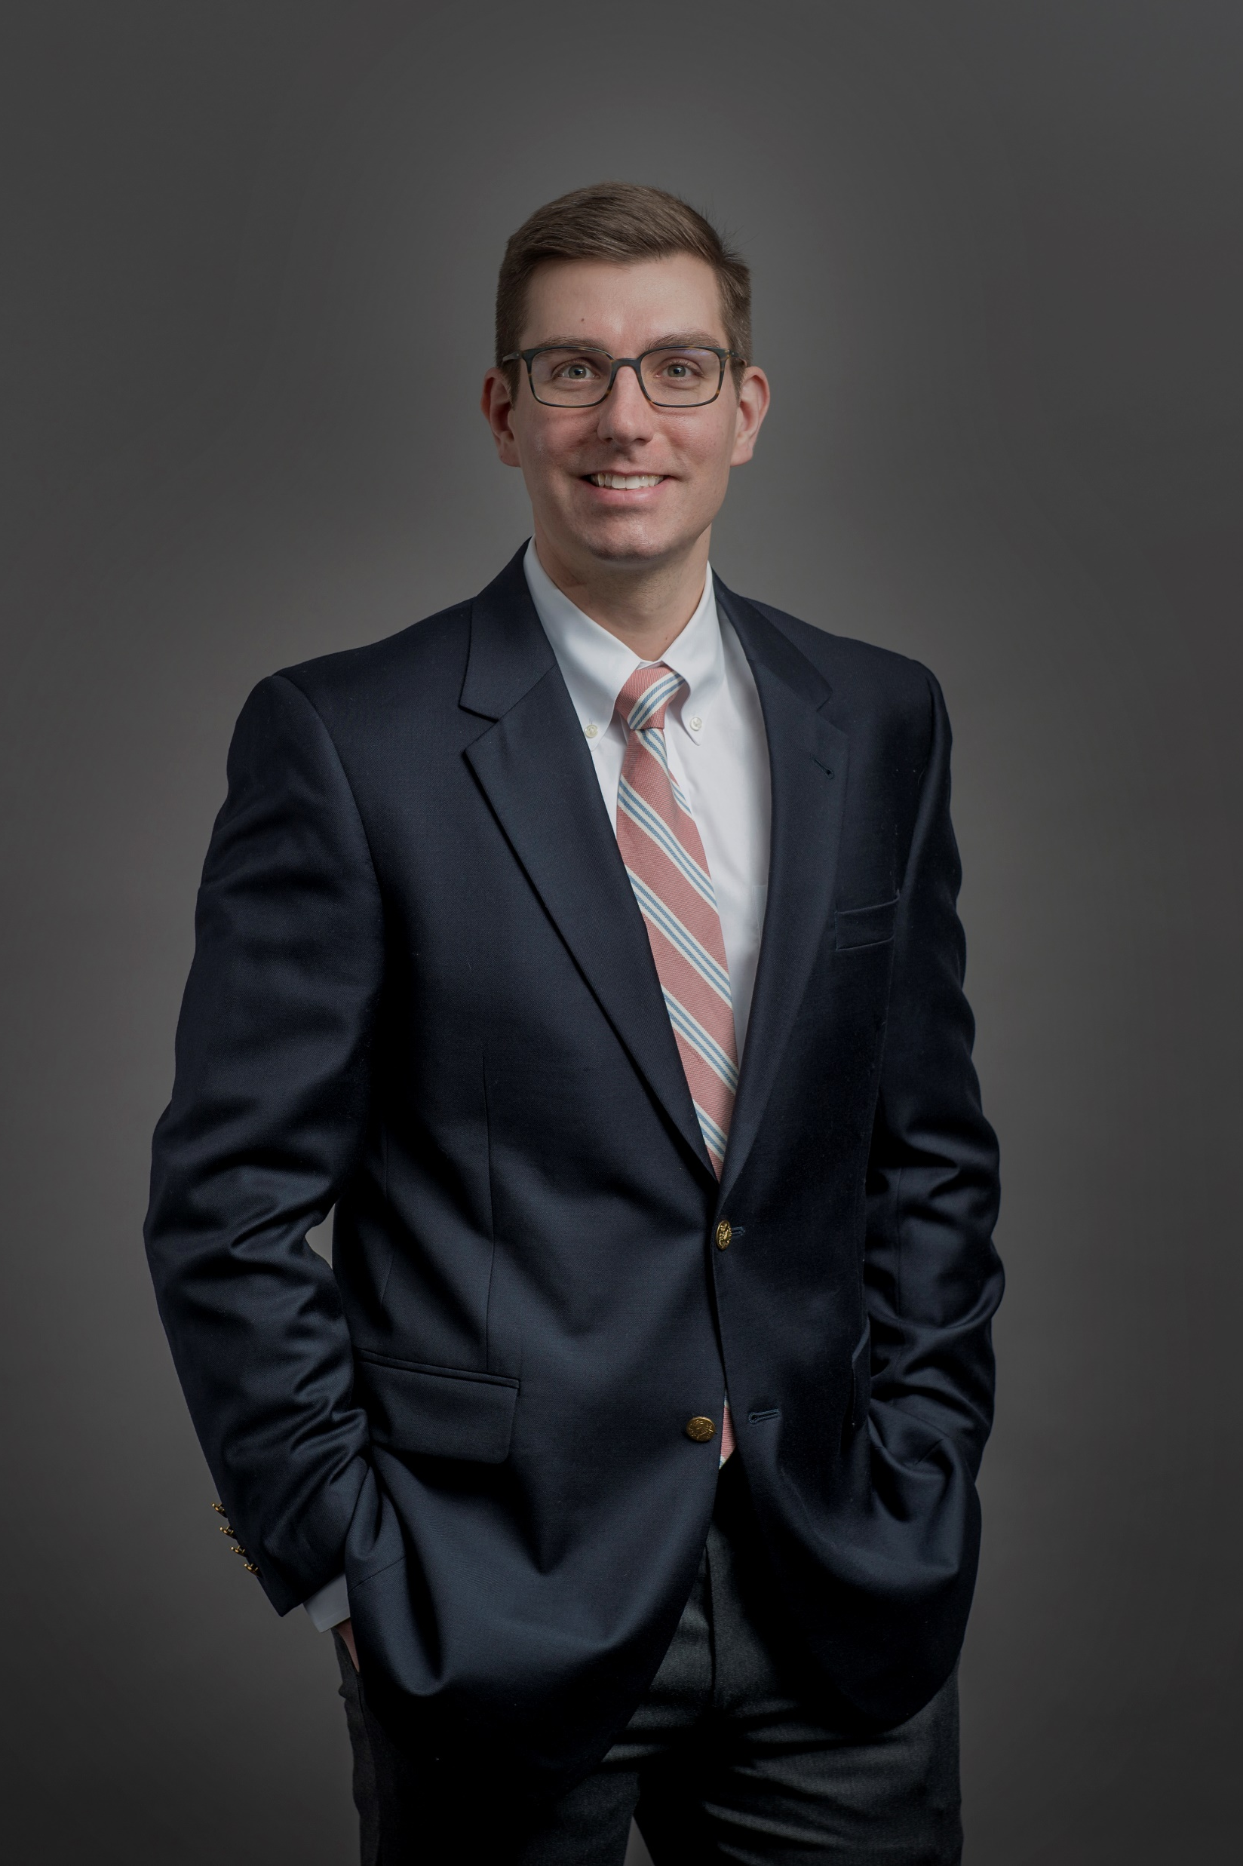
Your Personal Hip & Pelvis Specialists
Jared
Patterson, MD
Marvin Leventhal, MD
Jean Simard, MD
Robert Lonergan, MD
LEARN MORE
BOOK ONLINE NOW
Stephen Waggoner, MD
Michael Neel, MD
Drew Wodowski, MD

Slide 9

Your Personal Knee Preservation Specialists
One of our 20 knee specialists is available at a time and clinic location of your choosing to help you get back to your passion. Start your relationship with the doctor who will help you today.
Book your appointment online at any time, or call our 24/7 OrthoStat urgent care line with an urgent injury (901.261.STAT).
LEARN MORE
BOOK ONLINE NOW

Slide 10
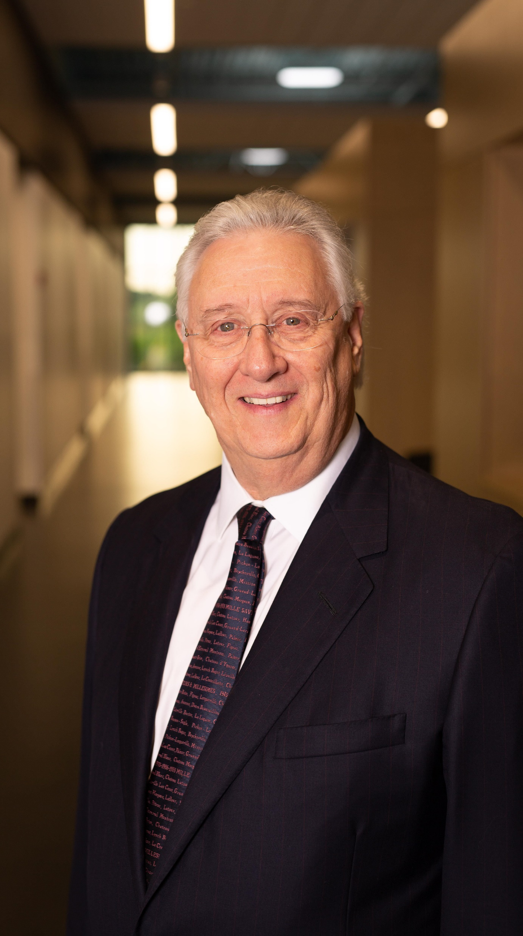
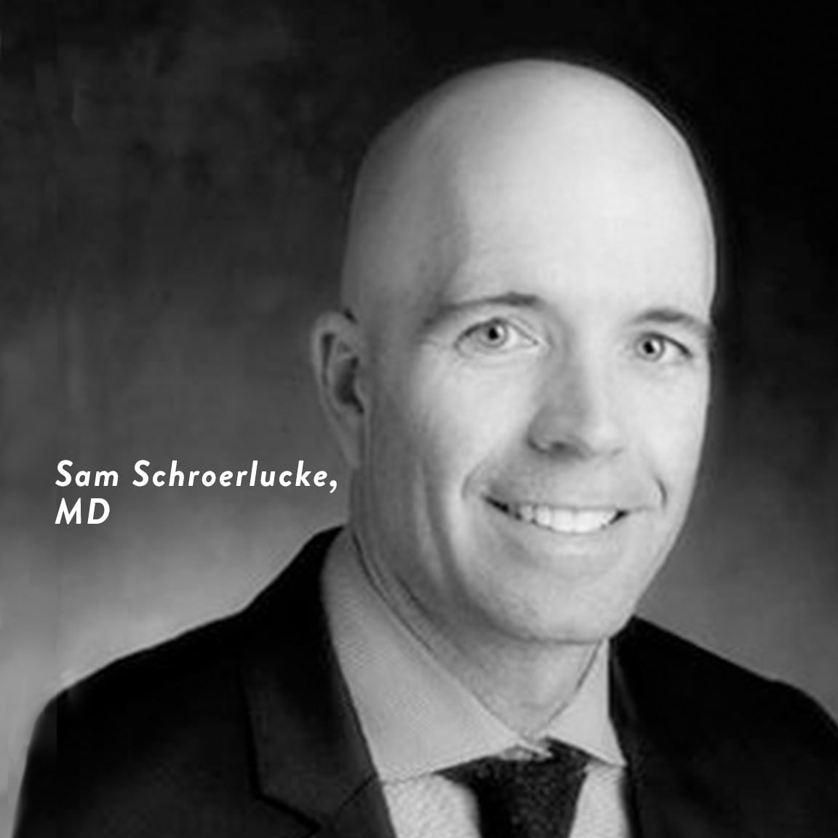
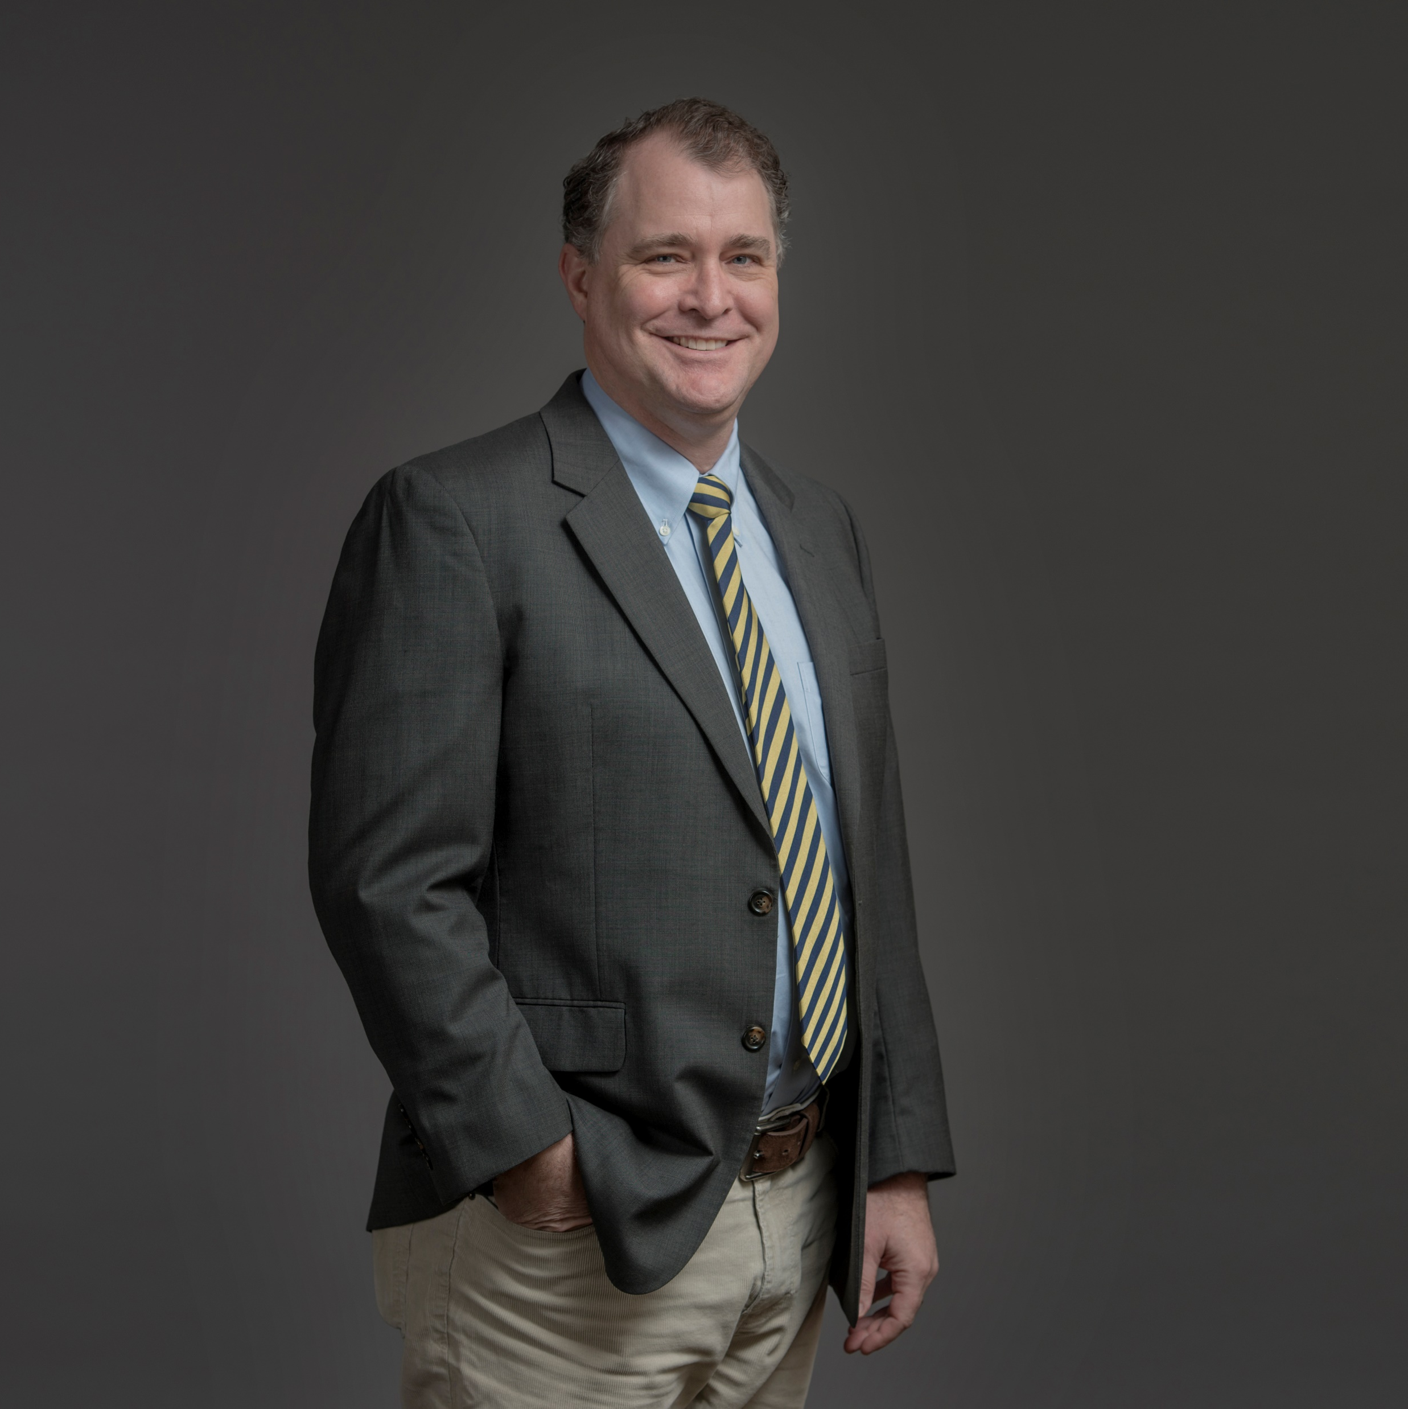
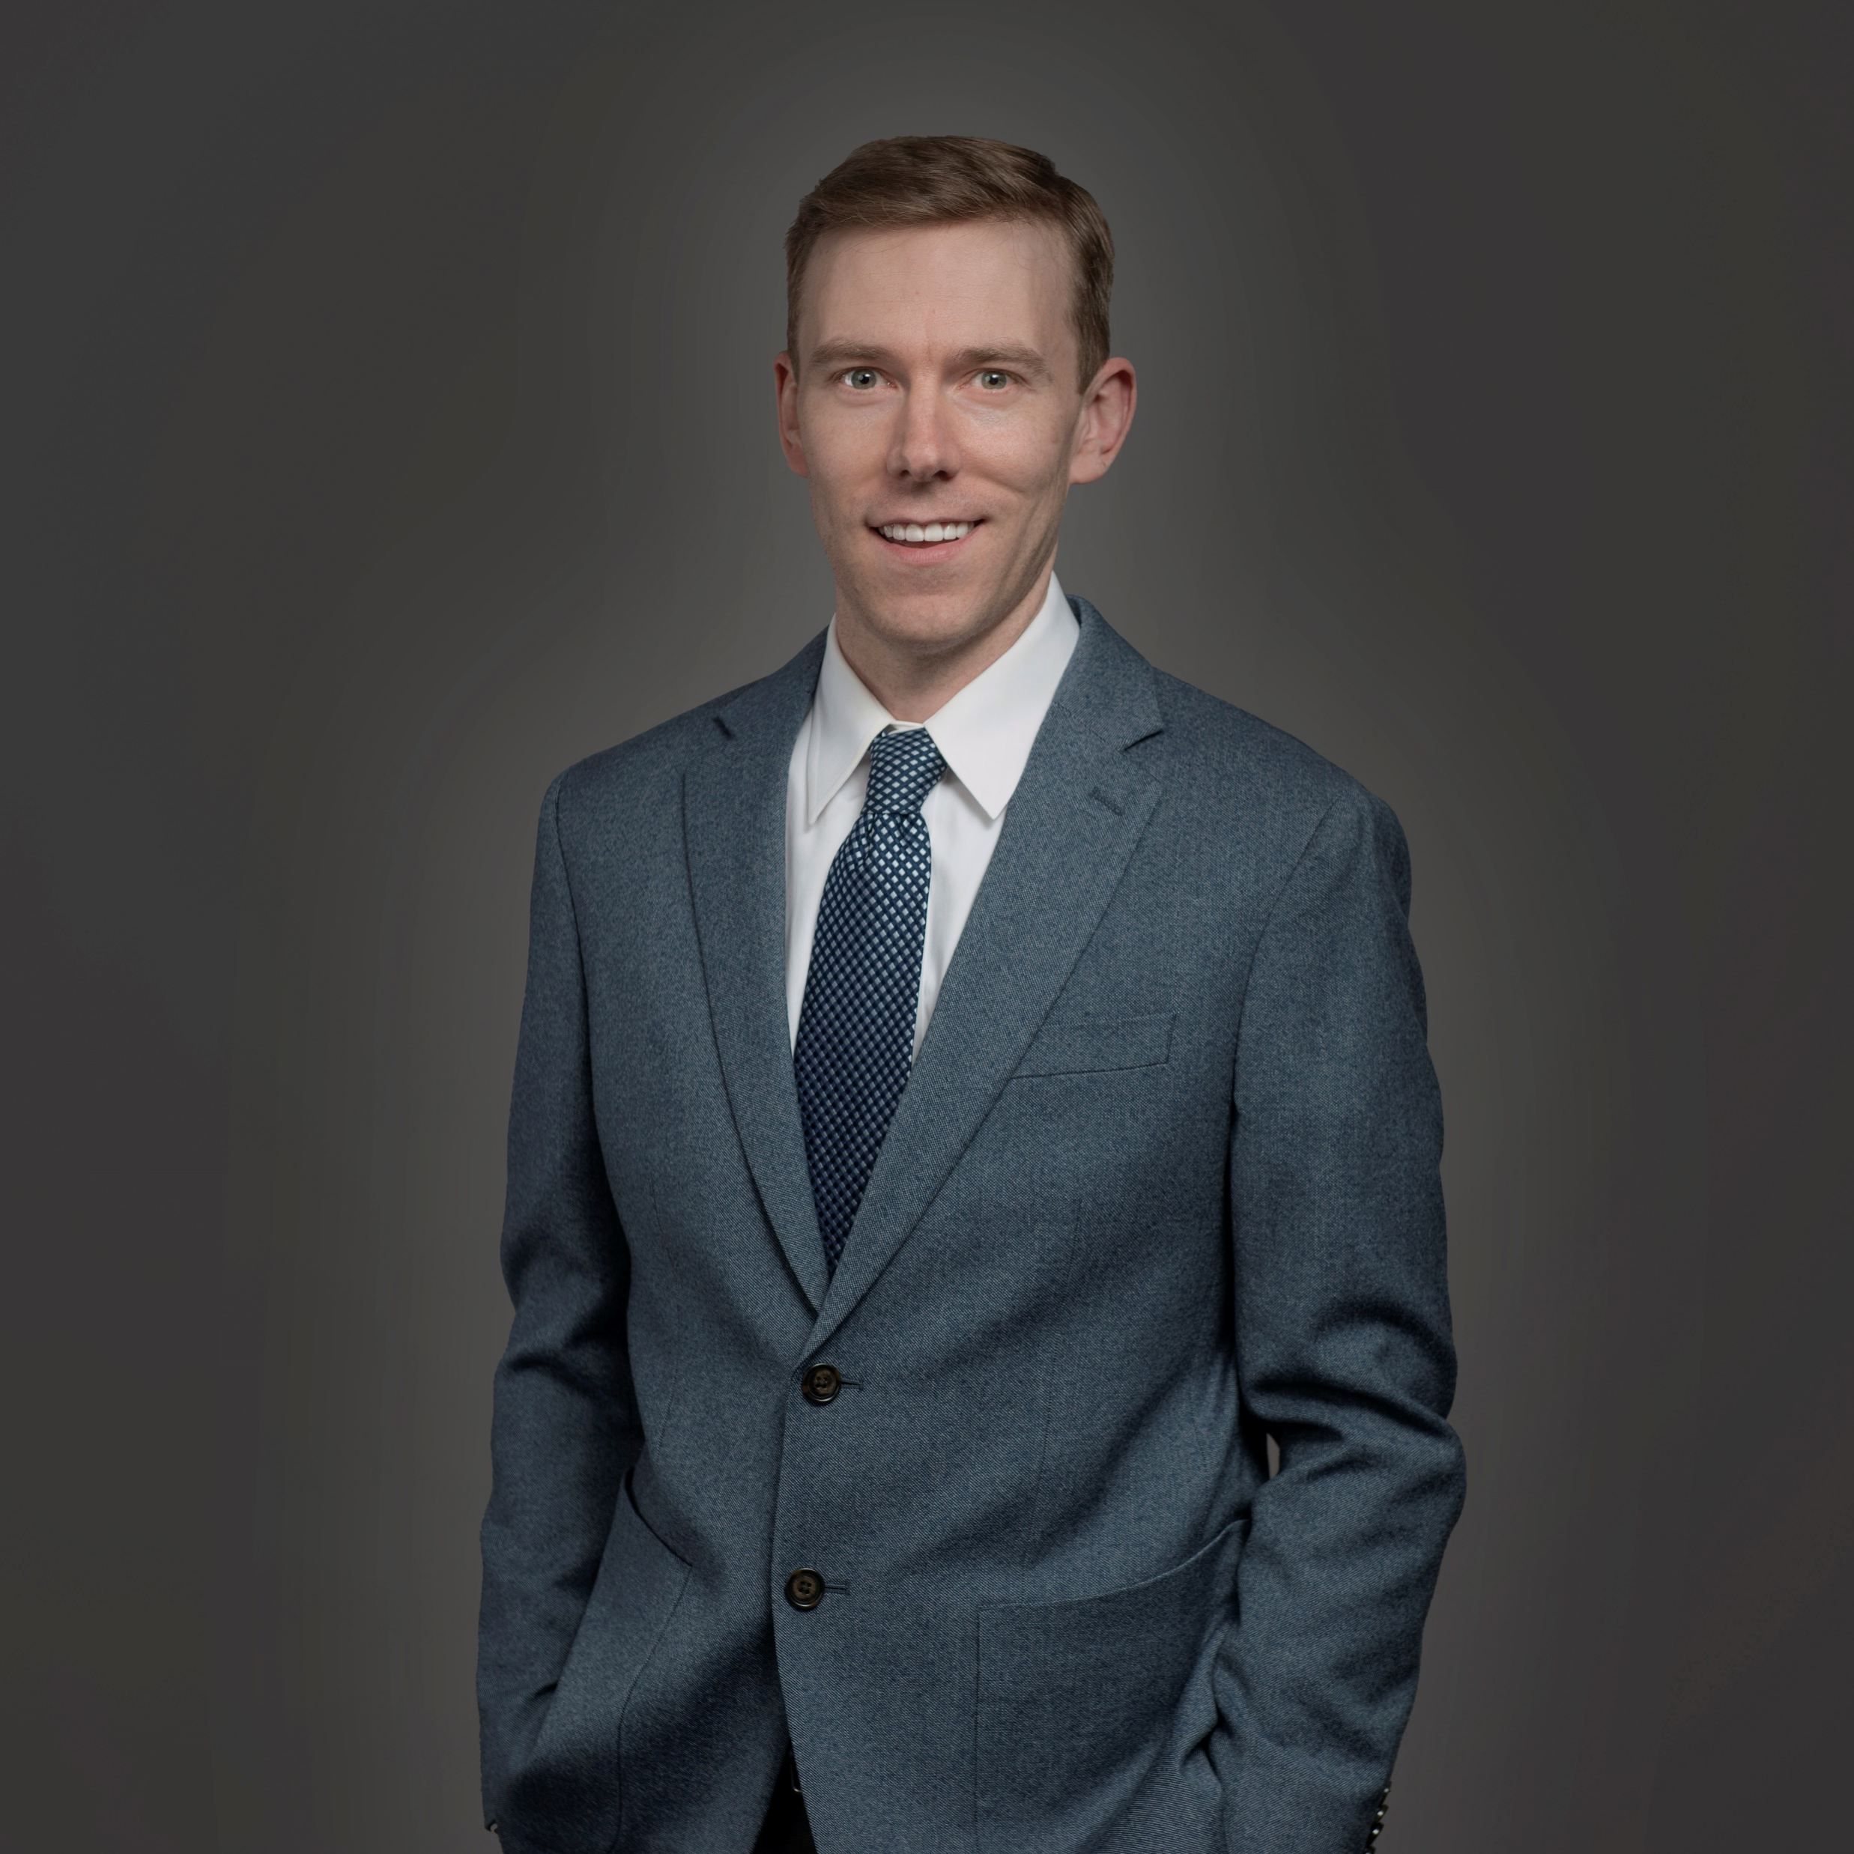
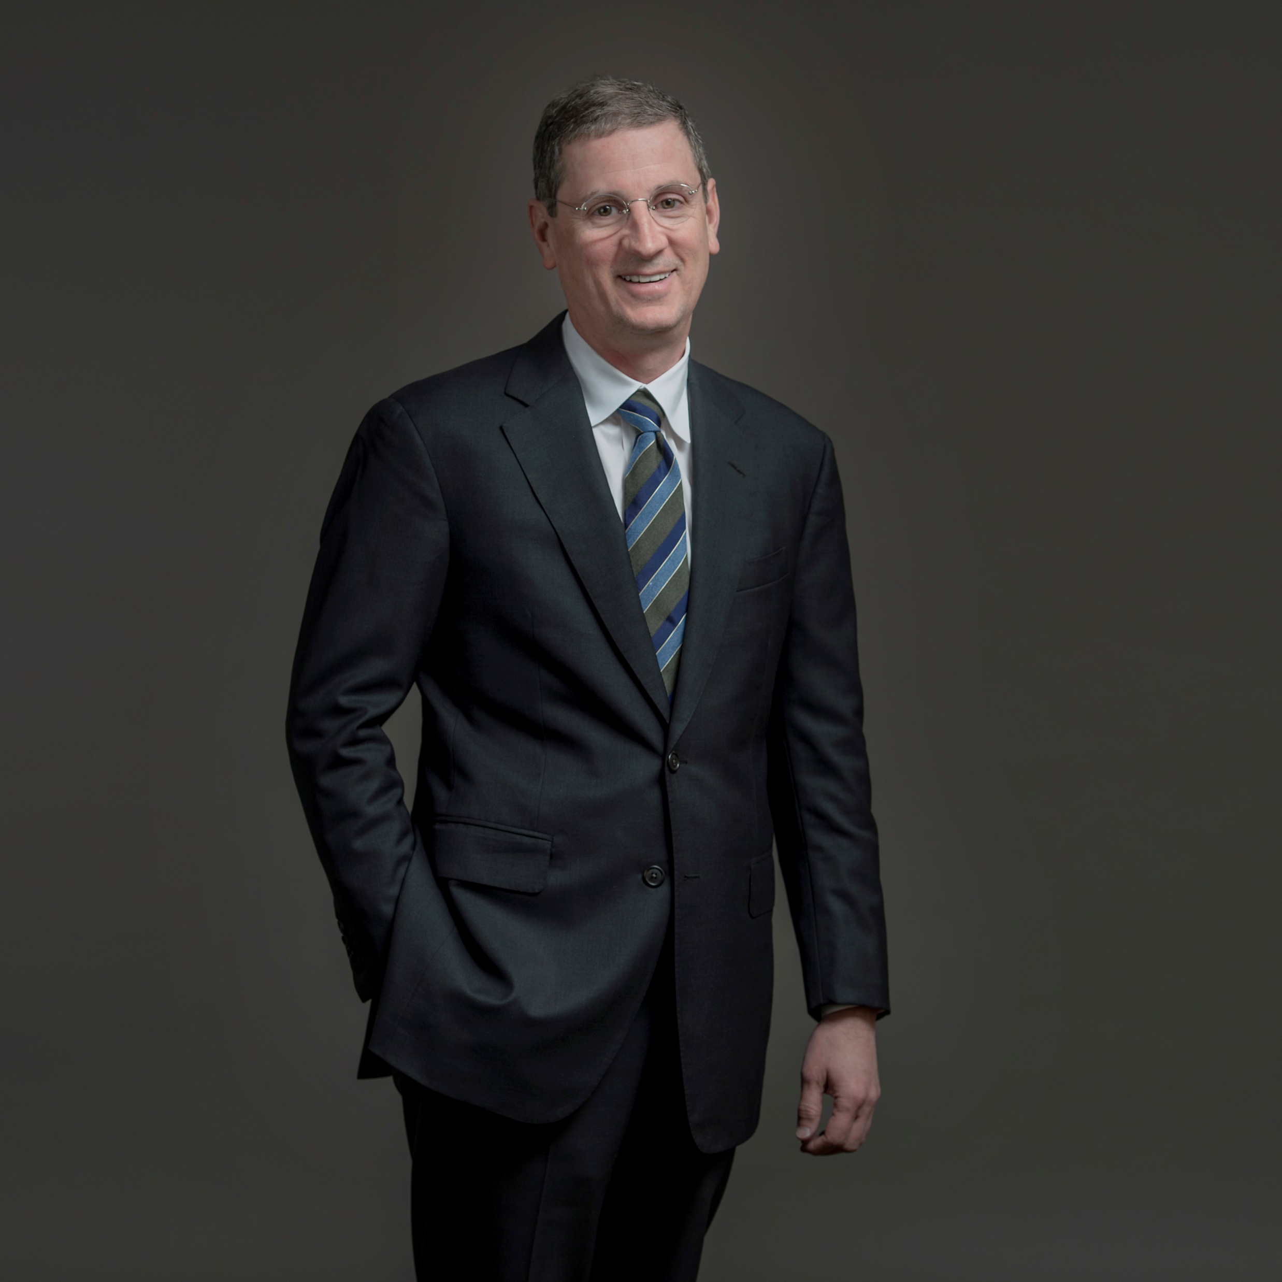
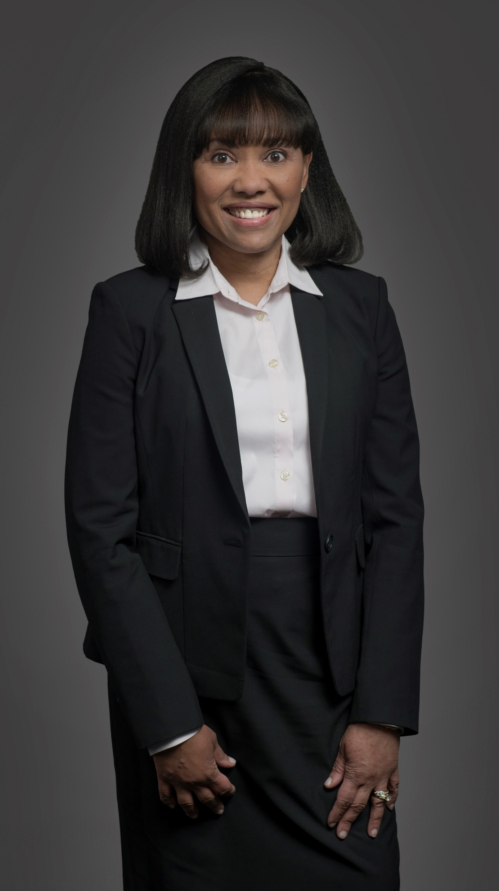
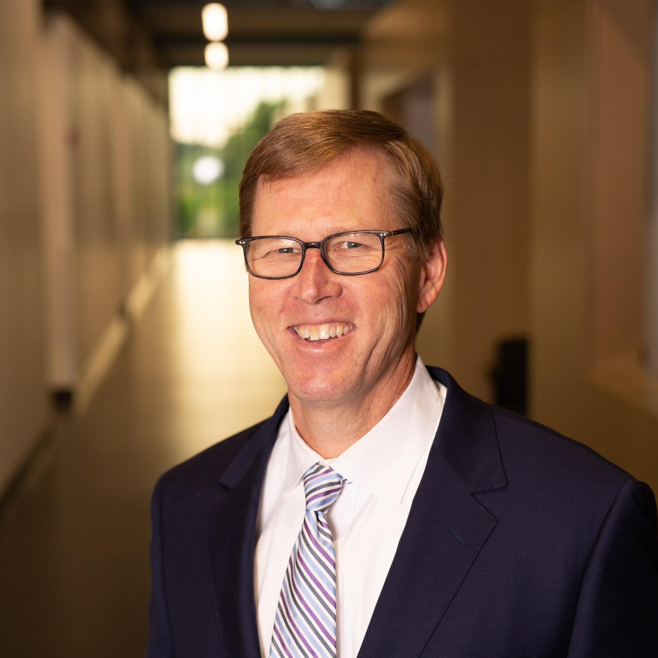
Your Personal Back & Neck Doctors
R. Riley Jones, MD
Sam Schroerlucke, MD
David J. Dowling, MD
Spencer Hauser, MD
The Back & Neck (Spine) team at OrthoSouth is comprised of expert physicians supported by PA’s, a strong physical therapy program, and 2 surgery center locations to address all of your non-surgical and surgical needs. When you make OrthoSouth your partner in spine health, you have a dedicated, personal expert physician ready to tailor your treatment to your needs and comfort.
LEARN MORE
BOOK ONLINE NOW
Sam Murrell, MD
Judith Lee-Sigler, MD

Slide 11
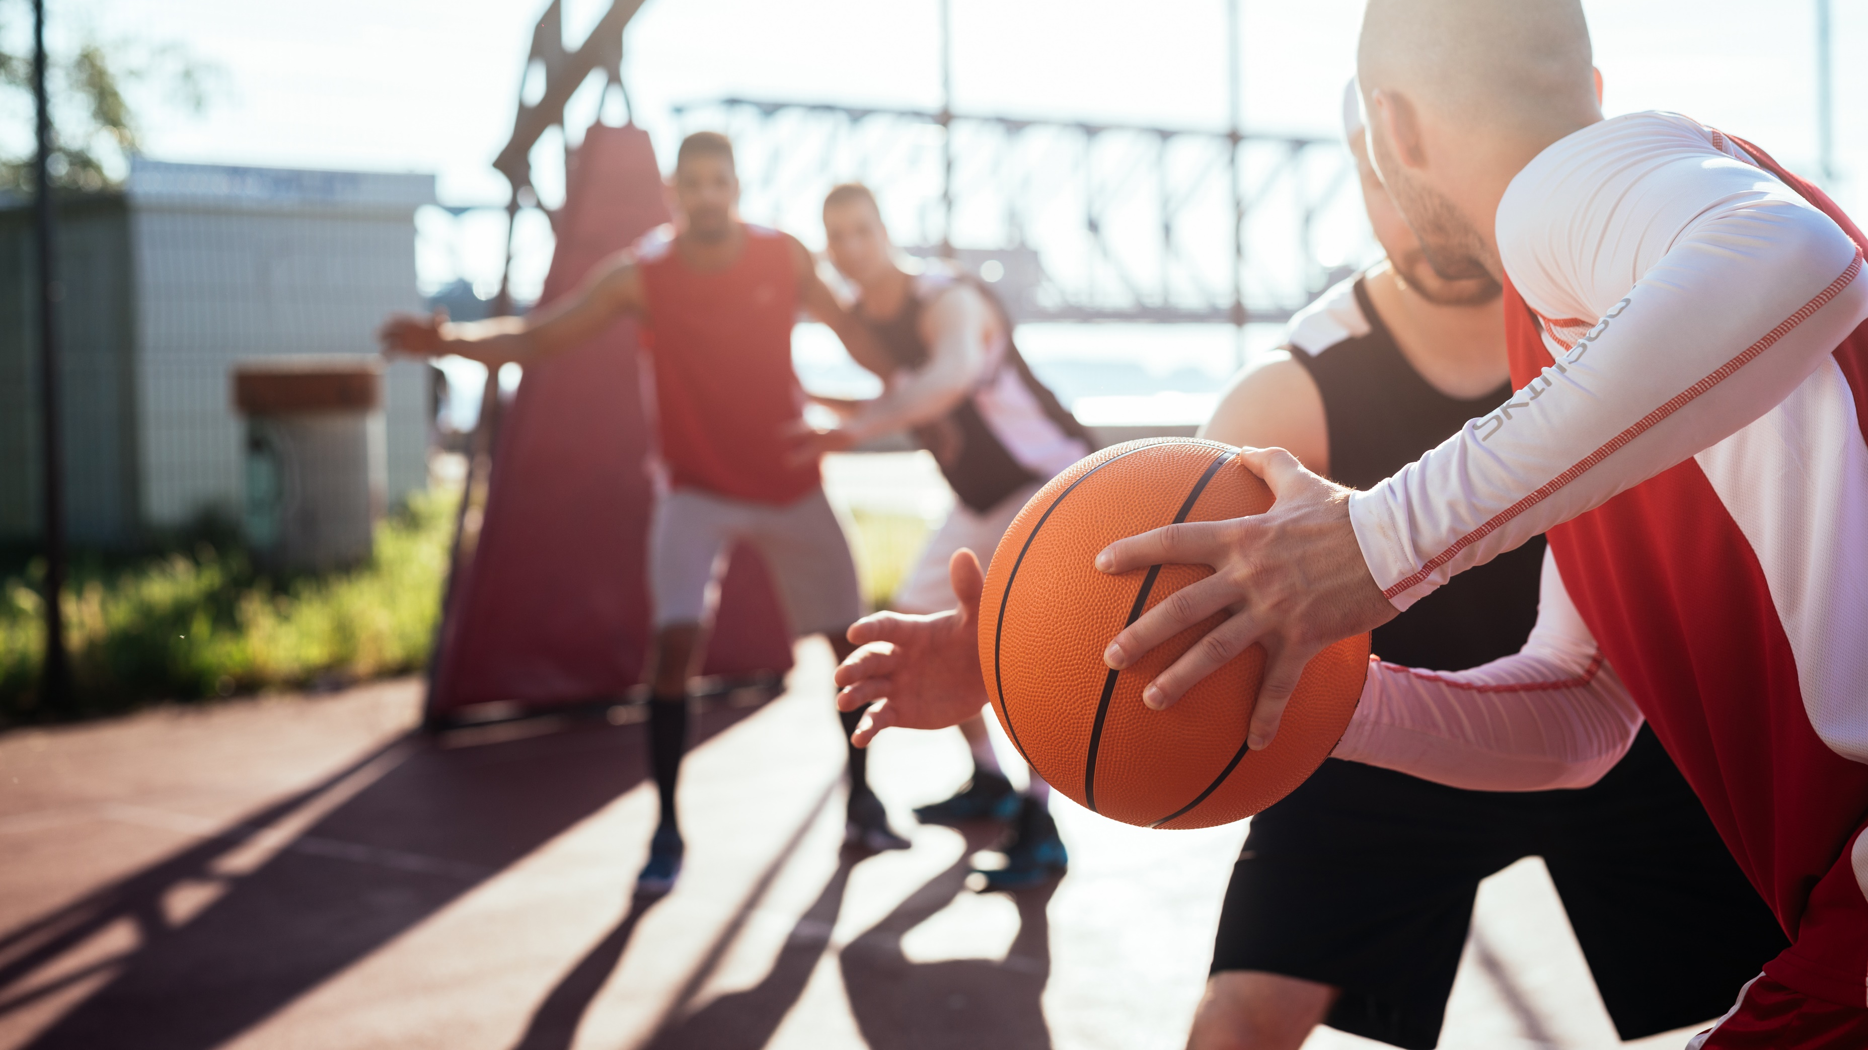
Your Personal
Shoulder Recovery Specialists
Start with shoulder pain, and one of our 15 innovative, experienced shoulder experts will listen, diagnose, and then work with you on a treatment plan that fits your needs and comfort. Book your appointment online from the convenience of your home.
LEARN MORE
BOOK ONLINE NOW

Slide 12

24/7 Urgent Orthopedic Care with OrthoStat
Supported by Telehealth Triage
901.261.STAT (7828)

Slide 13
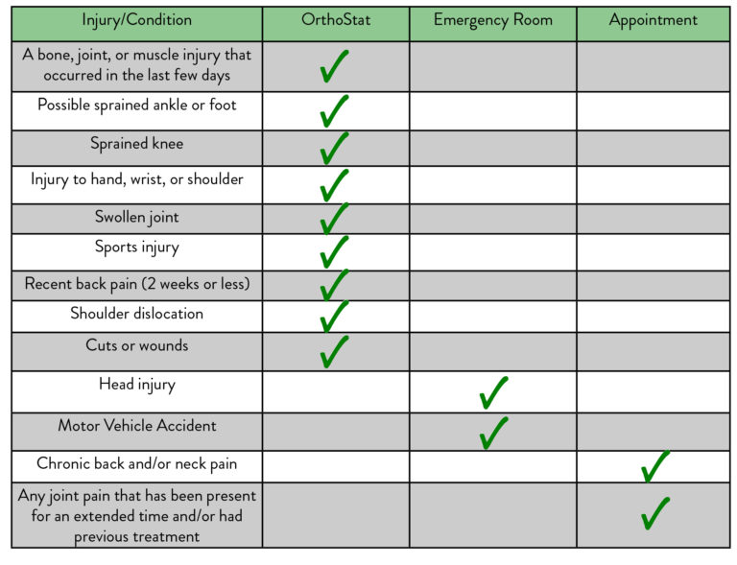
When to Visit OrthoStat
Why OrthoStat?
Typically less expensive than an ER visit
Less wait time compared to an ER visit
Advanced imaging and diagnostic technology available onsite at OrthoStat
Easy transition to subspecialty care for treatment and follow-up
Exceptional customer service in an urgent care setting
BOOK URGENT CARE APPOINTMENT ONLINE
Call OrthoStat Urgent Care Line
901.261.STAT

Slide 14

Now Offering Telemedicine
Save time and enjoy a visit with your doctor from the comfort and security of your home.
Including for Physical Therapy
*Request when you book your appointment*

Slide 15
Locations
We have 8 clinic locations to serve you. Visit http://orthosouth.org or call us at 901.641.3000 to select the location and physician most convenient to you.
6286 Briarcrest Ave.
Memphis, TN 38120
P: (901) 641-3000
F: (901) 259-1698
M-TH: 8 AM – 8 PM ; F: 8 AM – 5 PM
Physical Therapy Clinic Hours
M-F: 8 AM – 5 PM
1244 Primacy Parkway
Memphis, TN 38119
P: (901) 641-3000
F: (901) 767-8666
M-F: 8 AM – 4:30 PM
Physical Therapy Clinic Hours
M-F: 8 AM – 5 PM
4515 Poplar Ave., Suite 206
Memphis, TN 38117
P: (901) 641-3000
F: (901) 373-0804
M-F: 9 AM – 5 PM
Physical Therapy Clinic Hours
M-F: 8 AM – 5 PM
8040 Wolf River Blvd., Suite 100
Germantown, TN 38138
P: (901) 641-3000
F: (901) 373-0804
M-F: 9 AM – 5 PM
Physical Therapy Clinic Hours
M-F: 8 AM – 5 PM
1995 US Hwy. 51 S.
North Physicians Office Building
1st Floor, Suite 208
Covington, TN 38019
P: (901) 641-3000
F: (901) 259-1698
TH: 8 AM – 12 PM
3045 Kate Bond Rd.
Bartlett, TN 38133
P: (901) 641-3000
F: (901) 373-0804
M-F: 8 AM – 4:30 PM
Physical Therapy Clinic Hours
M-F: 8 AM – 6 PM
7580 Clarington Cove
Southaven, MS 38671
P: (901) 641-3000
F: (901) 259-1698
M-F: 8 AM – 5 PM
Physical Therapy Clinic Hours
M-F: 8 AM – 5 PM
310 Judge Smith Drive
Marion, AR 72364
P: (901) 641-3000
F: (901) 259-1698

Slide 16
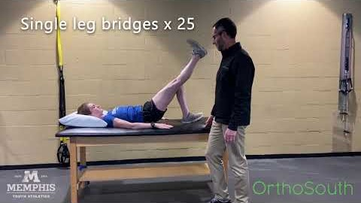
Stretches and Exercises to Manage “Runner’s Knee”
This video offers a few simple steps to help strengthen your knee when recovering from “runner’s knee.”

Slide 17
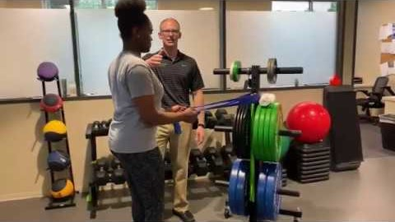
Exercises for Shoulder Pain
OrthoSouth's Steven Chipman, PT, DPT, SSRC, Cert MDT, and Catherine Taylor exhibit exercises to help relieve shoulder tendonitis.

Slide 18
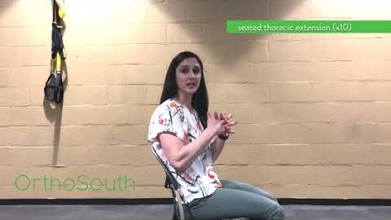
Stretches for Upper Back and Neck Pain
OrthoSouth Physical Therapist Anna Laura Kaspar, PT, DPT exhibits three helpful stretches to relieve upper back and neck pain.

Slide 19
orthosouth.org | 901.641.3000

