Slide 1

Improving Employee Health and Wellbeing One Step at a time

Slide 2


FOCUS AREAS
$
PHYSICAL
EMOTIONAL
FINANCIAL
SOCIAL

Slide 3



WAYS TO ENGAGE - VIRTUALLY
1:1
DIGITALLY
EVENTS
Financial advice
Ask the dietician
Ask the physician
Counseling
Websites
Apps
E-Newsletters
Conference Calls
Webinars
Fitness Classes
Workshops
Training

Slide 4


Slide 5

Operation Hope
Virtual Workshops
For dates and to register, visit www.memphistn.gov/learning

Slide 6
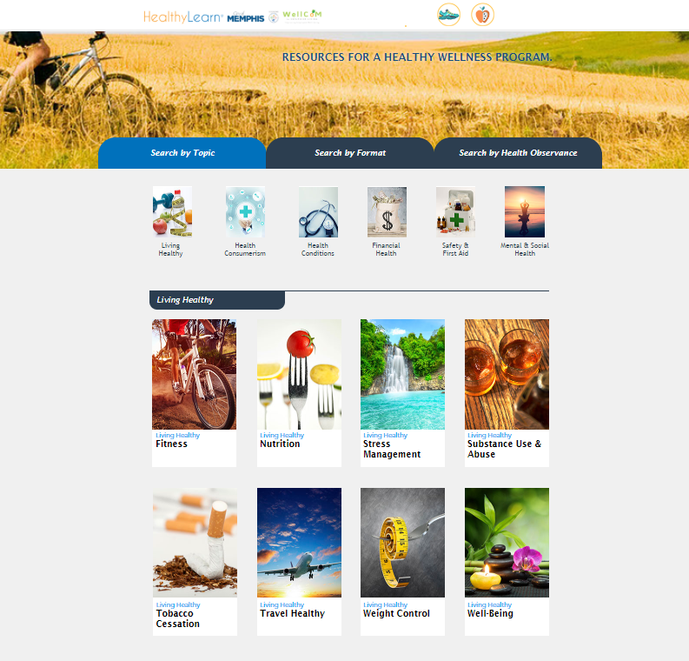
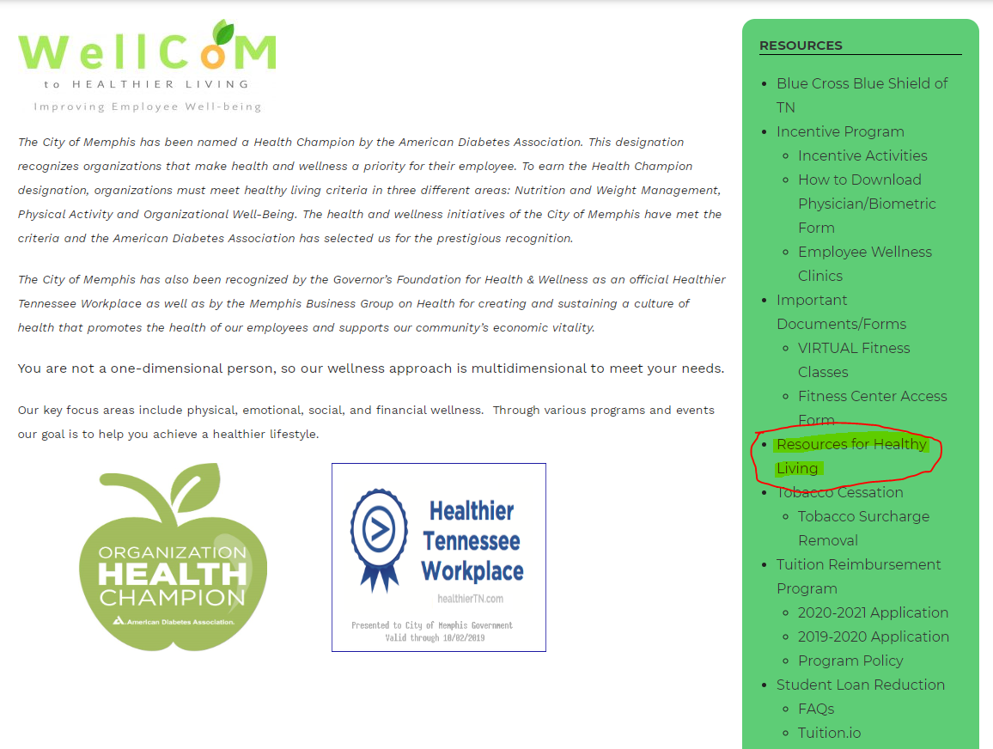
HEALTHY LEARN
Online wellness resource for various health topics, articles and videos.
Access by visiting totalrewards.memphistn.gov/wellness.
In the green column, click Resources for Healthy Living

Slide 7


WELLNESS INCENTIVE EXTENSION
Great news! The wellness incentive program has been extended!
Earn dollars by completing activities by December 31, 2020
Redeem by February 28, 2021
Ways to Earn Incentive Dollars
Behavioral Health Visit or Telehealth Visit
Annual Wellness or Well-women Exam
Biometric Screening
Pick One Options
  Personal Health Assessment
  Lifestyle Health Coaching
  Walk 1 Million Steps
  Care Management

Slide 8
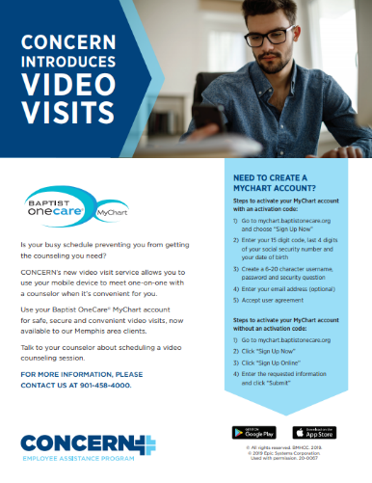
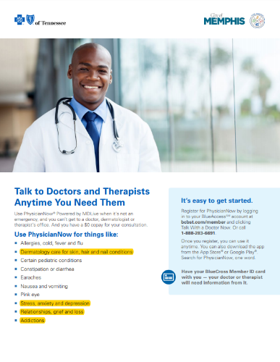
Earn Wellness Dollars for Behavioral Health Visit

Slide 9
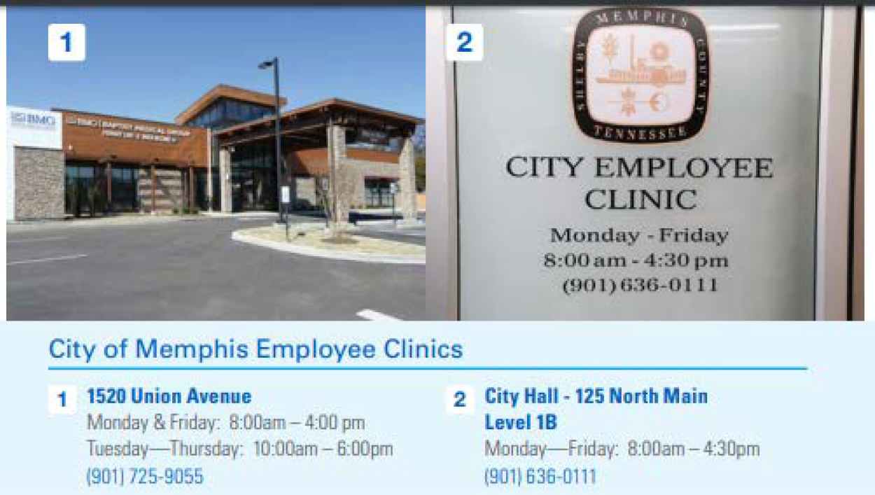
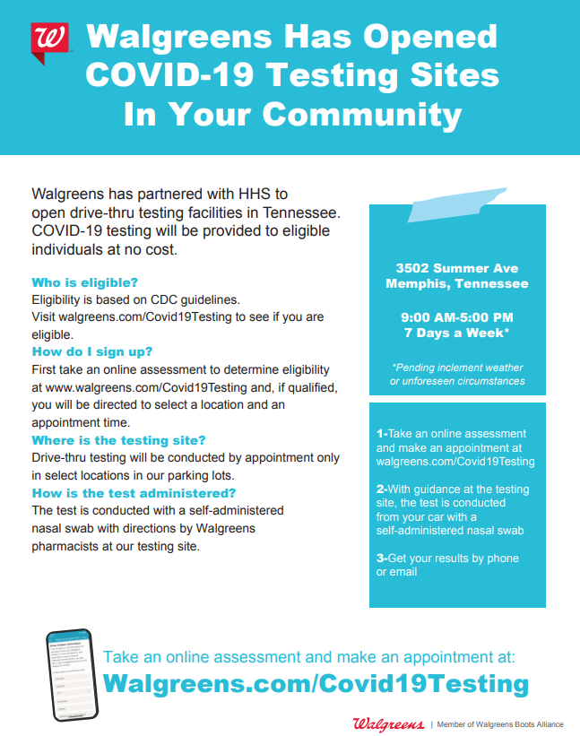

COVID-19 & ANTIBODIES TESTING

Slide 10

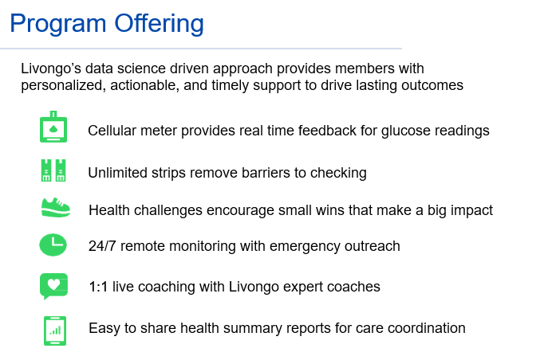

Slide 11

We’re Here For YOU
HR Remote Services
Wellness
General Wellness questions - wellness@memphistn.gov or 901-633-8661
24/7 Blue Cross Blue Shield Nurse Line - 800.818.8581
24/7 Physicians Now TeleHealth - Register for Physician Now at bcbst.com/member and click "Talk with a Doctor Now" or call 1-888-283-6691
City of Memphis Employee Clinic - 1520 Union Ave. 901-725-9055 or 901-276-2410. Employees are encouraged to call before coming to clinic. If symptomatic & meet testing criteria, they can receive testing in parking lot
Concern Employee Assistance Program - Now conducting counseling by telehealth (video) or telephonic visits. Call 901-458-4000 or visit www.concernonline.org
Virtual Fitness Classes & Financial Wellness Workshops
Dental Incentive - Email your dental cleaning Explanation of Benefits from MetLife to wellness@memphistn.gov.
Public Service Loan Forgiveness, Tuition Reimbursement, Student Loan Assistance Program - please email wellness@memphistn.gov

Slide 12
PASSWORD = BE WELL!

